Slide 1
Effective Public Procurement for public service delivery:
Good Practices from the OECD Experience
Paulo Magina
Head of the Public Procurement Unit, OECD
RICG Meeting
Montego Bay, 2 Nov. 2016

Slide 2
Contents
Who are we?
Public Procurement matters….
Strategic Public Procurement
Delivering Infrastructures

Slide 3
Who we are

Slide 4
The OECD…
…is the global organisation that drives better policies for better lives:
The OECD provides a forum where countries compare and exchange policy experiences, identify good practices, discuss emerging challenges and adopt recommendations for better policies.
The OECD’s mission is to promote policies that improve economic and social well-being of people around the world.
www.oecd.org

Slide 5
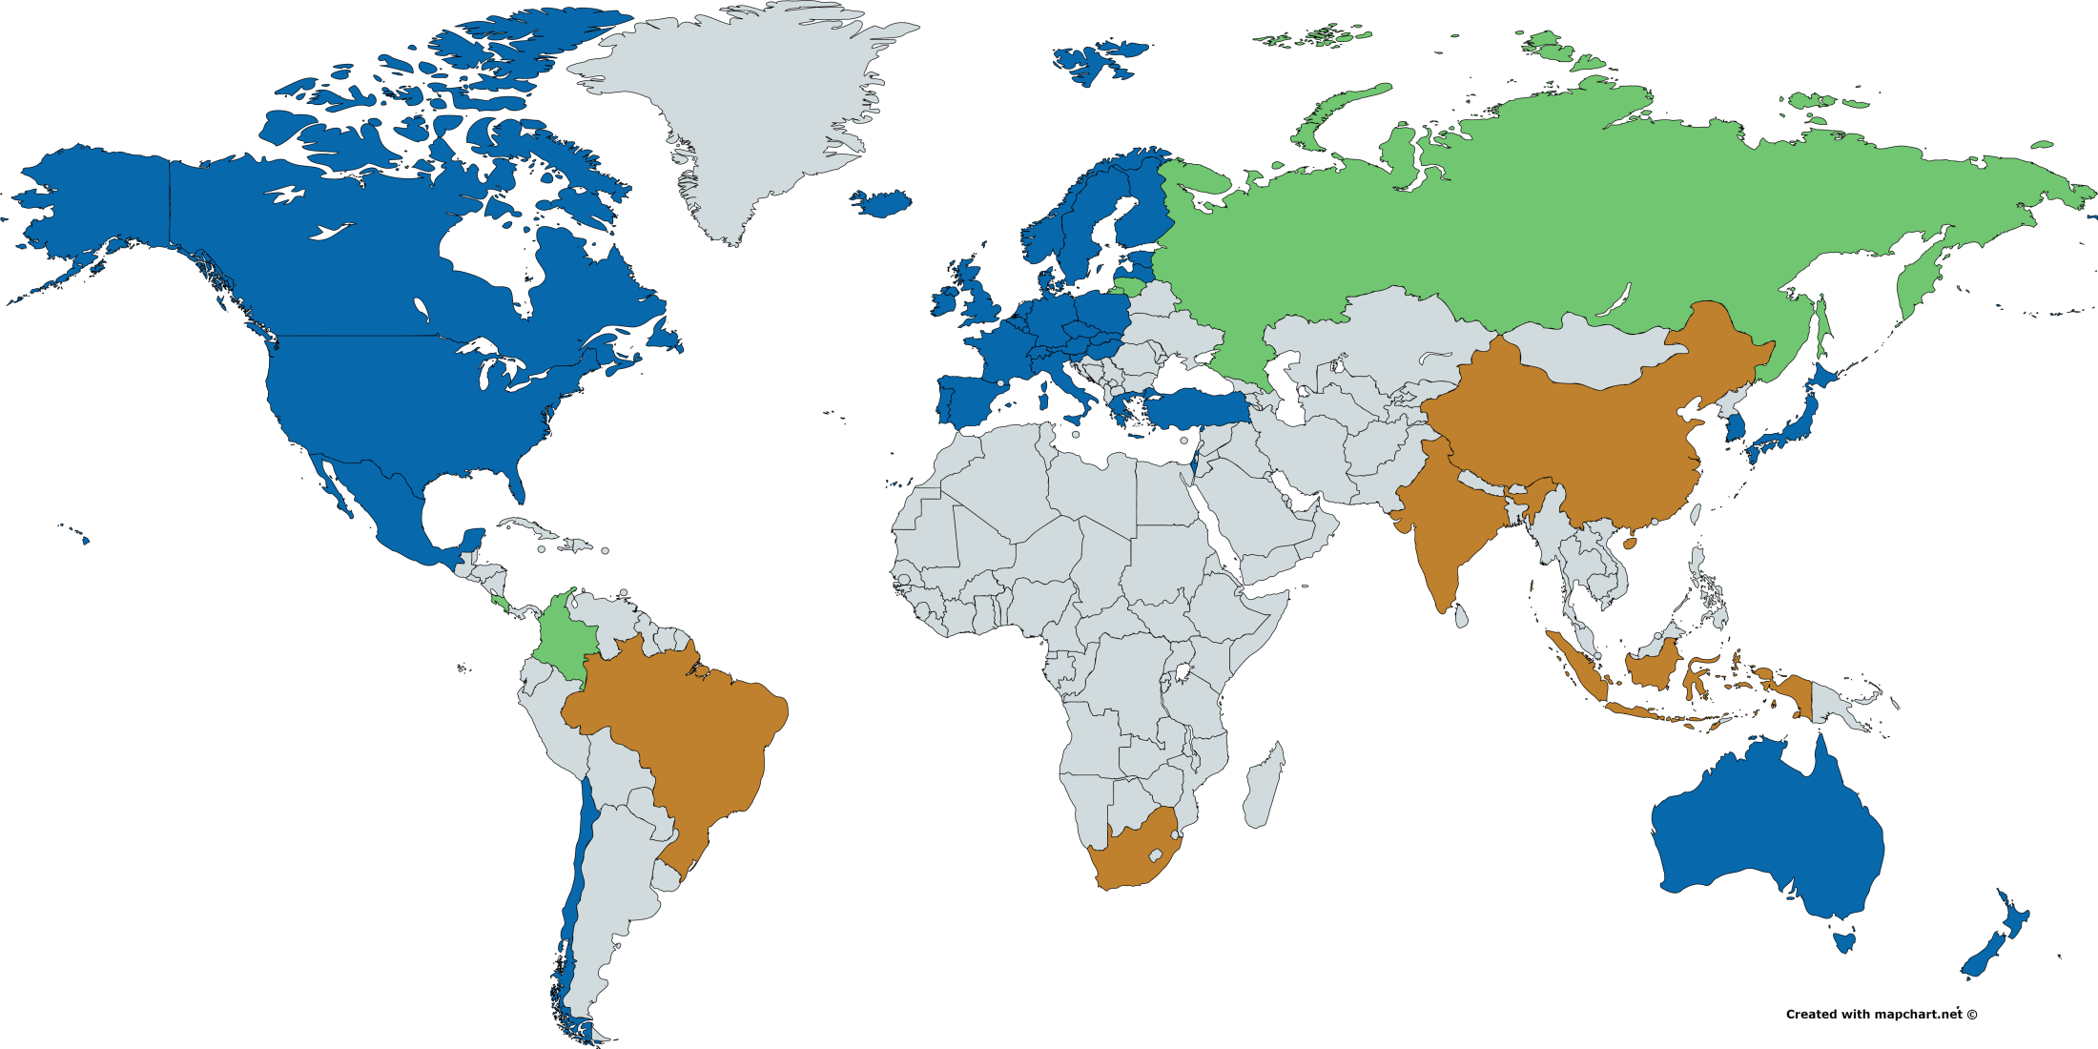
35 member countries, 4 accession
5 Key partners

Slide 6
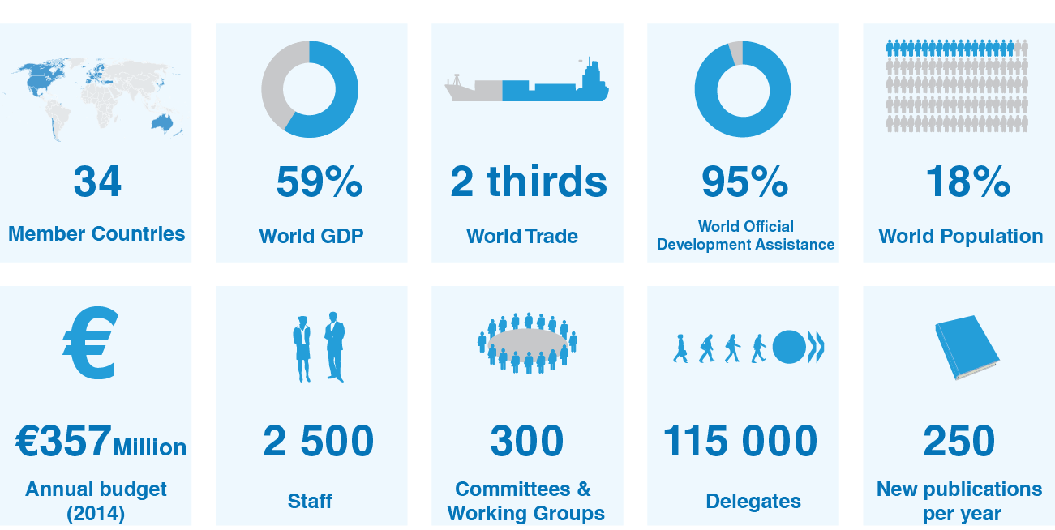
Fast facts

Slide 7












Part of a global community

Slide 8
Public procurement matters …

Slide 9
Public Procurement matters
It stands as a crucial pillar of strategic governance for any government body;
It is also a high-risk area due to the close interaction between private and public spheres
Governments face the challenge of ensuring that different objectives are clear, work together and overlaps or conflicts are avoided.

Slide 10
Public Procurement really matters
Government procurement as share of GDP and of total govt. expenditures
Source: OECD National Accounts Statistics. (2013)

Slide 11
OECD contribution to reforming public procurement
Building evidence from useful, reliable and comparable data across OECD countries on the performance of public procurement – Government at a Glance; Key Performance Indicators
Undertaking hands-on peer reviews that provide assessment of public procurement systems, either national or sectorial, and tailored proposals to address implementation gaps in specific context – in Italy, Greece, Northern Ireland but also US, Korea, Mexico, Colombia, Chile, Peru, other EU countries like Slovakia or Bulgaria
Organising policy dialogue to share insights & shape directions for future reforms, build strategic partnership with private sector - G20
Identifying good practices and providing international standards on public procurement – Compendiums on Green Procurement, Transparency, Accountability and Integrity, now Innovation, SME’s following

Slide 12
The 2015 Recommendation on Public Procurement: 12 integrated principles
Transparency
Accountability
Access
Participation
E-Procurement
Efficiency
Evaluation
Integration
Capacity
Integrity
Balance
Risk Management

Slide 13
Implementing the 2015 Recommendation:
Encompassing OECD procurement activities
Vision: An international reference for public procurement standards, good practice and forward-thinking
Implementation of the Recommendation 2015-2018
  Building evidence:
    Assessment tools, MAPS
    Key performance indicators
    Strategic use of PP => Green, SME, innovation
    Professionalisation
    G@G
    eProcurement
  Toolbox - innovative, practical, collaborative solutions
Policy instrument
Network
Toolbox
Reviews
Data

Slide 14
Strategic Public Procurement

Slide 15
Development of PP Strategy/ Policy to support secondary policy objectives (2016)

Slide 16
Mandatory use of public procurement for secondary policy objectives

Slide 17
Approaches to support SMEs and innovative goods and services

Slide 18
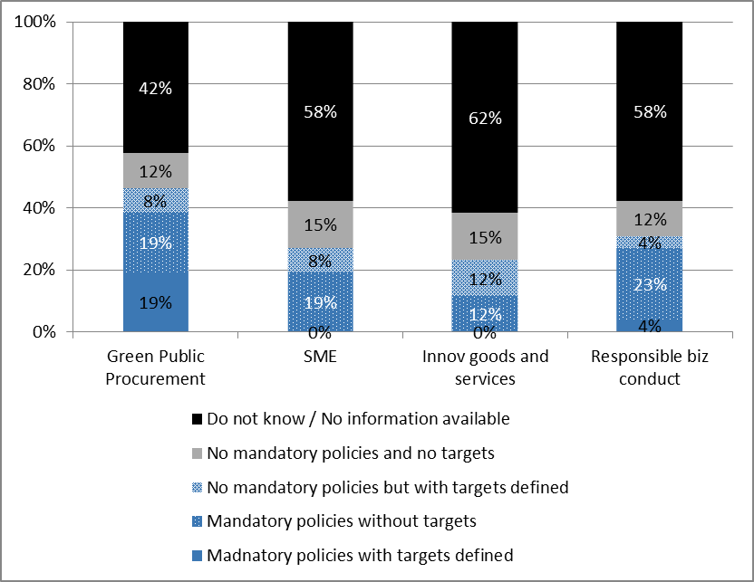
Use of PP to pursue secondary policy objective at the sub-central level

Slide 19
Strategic public procurement at the OECD
Measuring of the results
Source: 2016 OECD Survey on Public Procurement

Slide 20
Delivering infrastructures

Slide 21
Infrastructure matters
Infrastructure investments are expected to provide tangible impacts on growth, quality of life and productivity.
Total global infrastructure investment requirements by 2030 will come to USD 71tn (3.5% of the annual World GDP from 2007 to 2030).
A large share of infrastructure investment are and will be borne by governments

Slide 22
Yet, projects are increasingly complex
Interconnected layers in governance structure
Strategic choices on infrastructure projects ownership and delivery modes
Project developments require responsive policy making

Slide 23
If not strategically managed, projects may falter
The “four Cs” in infrastructure projects:
Inadequate Cost recovery
Corruption
Insufficient Competition
Low Credibility of institutions.

Slide 24
Towards effective delivery of infrastructure projects
Among other tools developed by the OECD, two major instruments can contribute to address the “four Cs”:
The Recommendation of the Council on Public Procurement
The Integrity Framework for Public Investment

Slide 25
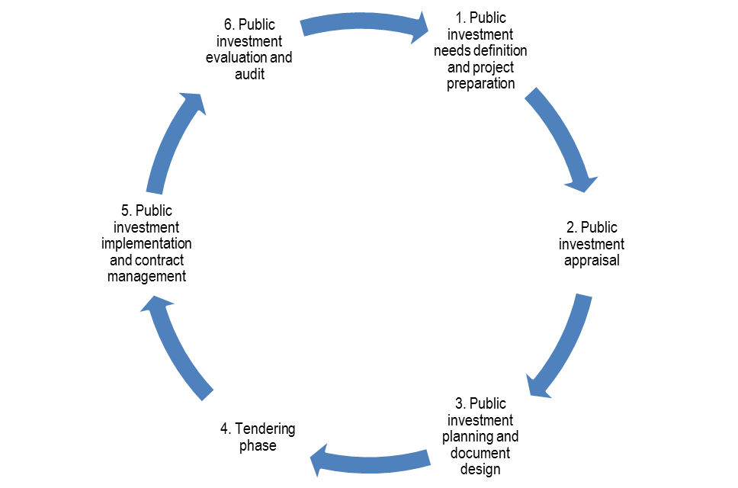
Covering the public investment cycle
Public investment cycle

Slide 26
OECD Integrity Framework for Public Investment: addressing the entire cycle
The Framework proposes measures safeguarding integrity at each phase of the investment cycle:
  Selection phase: making investment decisions in the public interest
  Appraisal phase: ensuring credible and objective estimations of all costs and benefits related to the project
  Planning phase: ensuring tender documents and processes do not unduly favour some stakeholders
  Tendering phase: ensuring processes that promote qualification, accountability and value for money
  Implementation phase: minimizing delays for completion, excess costs, and ensuring quality
  Evaluation phase: auditing the government project upon completion by an independent institution

Slide 27
Countries’ experience in the governance of infrastructures
In 2016, the OECD issued a survey on the governance of infrastructures:
  Questionnaire responded by 26 OECD members and key partners
  “Good practices” can be found in a majority of countries
  No country is a “best practice”

Slide 28
Main findings
Coordination across levels of governments is common in countries with long term strategic plans. However, intergovernmental coordination mechanisms for infrastructure are not frequent.
The most relevant criteria for determining the delivery modality are financial criteria, such as public sector financial resources, availability of public sector capacity, cost recovery possible from users, as well as the outcome of a quantitative analysis.

Slide 29
Main findings
Governance throughout the infrastructure lifecycle needs to be improved. Most institutions are responsible for the development of infrastructure policy and the improvement of infrastructure performance. Responsibilities for the assessment and monitoring of the projects are less defined.
Systematic data collection on the infrastructure asset’s performance is infrequent.

Slide 30
Key Factors for effective delivery of infrastructures

Slide 31
Creating the right environment
An infrastructure environment conducive to effective delivery of projects starts with a skilled and mature organisation, notably for the procurement workforce.
Organisational capacity is a prerequisite for public procurement.

Slide 32
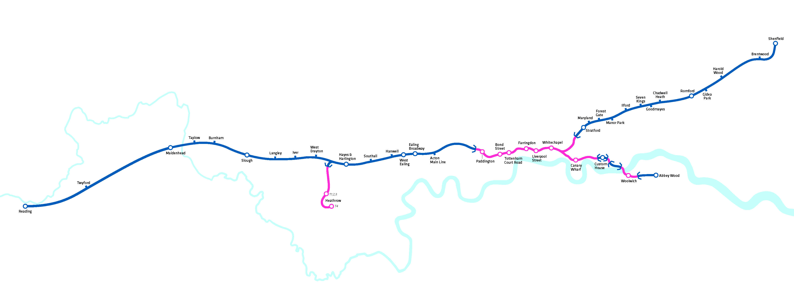
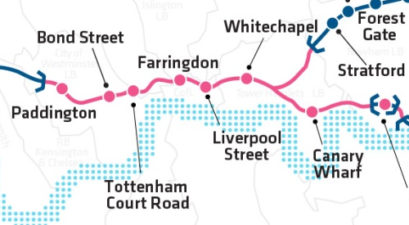
Capacity tests
The example of Crossrail
Source: Crossrail

Slide 33
Engaging Stakeholders - Consultations
Mandatory consultation processes are used at all stage of the infrastructure governance process
In the survey, for more than half of the countries, consultation is also mandatory in the evaluation of infrastructural needs and for the decision process of prioritising infrastructure projects.
During the construction phase, mandatory consultation is less common.

Slide 34
Consultation across the project cycle
(2016) OECD Survey on Governance of Infrastructures

Slide 35
Identifying project ownership and the most effective delivery mode
Infrastructure governance ownership
Direct provision
State-owned enterprises
Privatisation
Infrastructure delivery modes
Traditional public works
Alliance contracting
PPPs or concessions

Slide 36
Achieving value for money
(2016) OECD Survey on Governance of Infrastructures

Slide 37
Ensuring sufficient competition
21 countries have a strategy in place that aims at ensuring a competitive tendering process. The choice of the most effective form depends on a number of considerations.
(2016) OECD Survey on Governance of Infrastructures

Slide 38

Reinforce trust in public institutions
Procurement processes for the New International Airport of Mexico City are subject to social oversight aiming at ensuring the integrity of processes

Slide 39
Oversight: from compliance to advice
The OECD and ANAC developed High-level Principles for Integrity, Transparency and Effective Control of Major Events and Related Large Infrastructure
These Principles promote the implementation of a « collaborative supervision and control » model

Slide 40
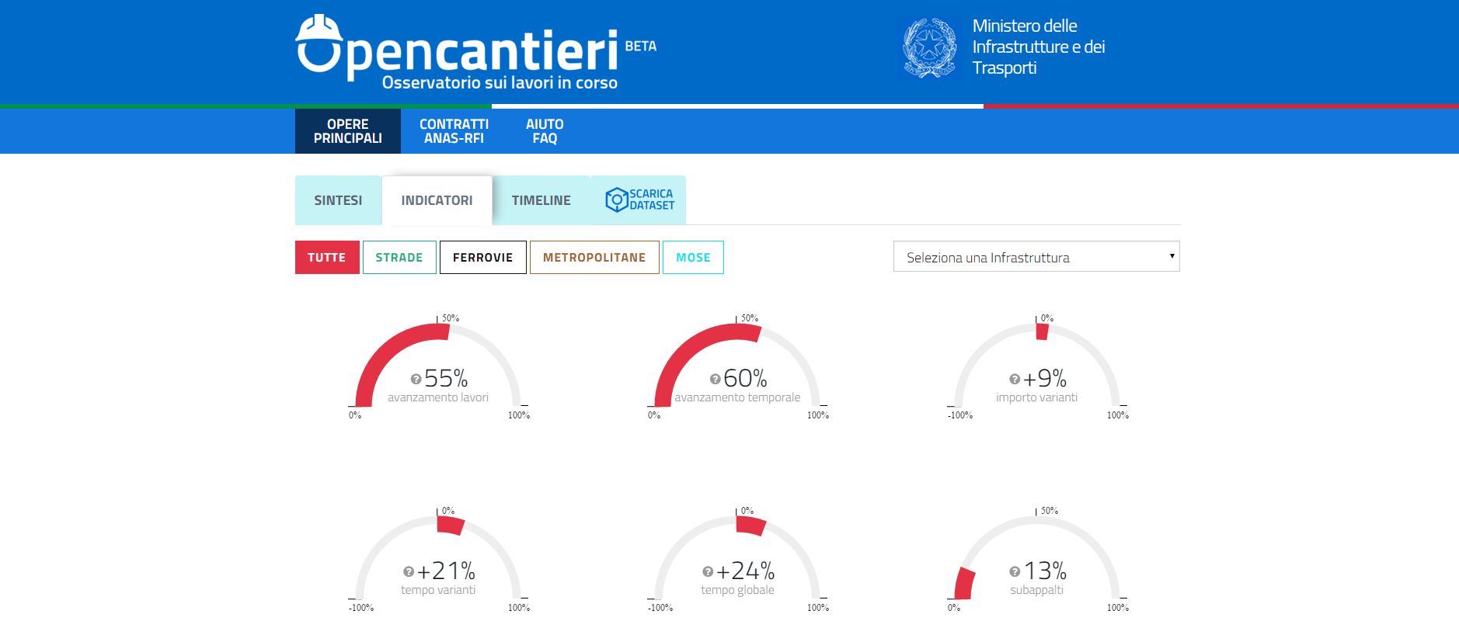
Shedding light on performance of infrastructure projects
  Open data initiatives and open contracting promote transparency in infrastructure projects and reinforce trust of citizens

Slide 41
The Key Factors for effective delivery of infrastructures

Slide 42
Ensuring transparency throughout infrastructure projects
Develop a comprehensive project risk map including integrity risks
Promote strategic oversight and coordinated governance models
Disclose project performance over time in a clear and understandable way

Slide 43
Key Success Factors to consider
Transparency, Accountability and Openness
Institutional Synergies, Collaborative Supervision and Control.
Multidisciplinarity and Governance Structures.
Early ex-ante controls and performance assessments.
Comprehensiveness and timeliness (of controls).
Adequate resources, skills and training.
International cooperation and access to data.

Slide 44


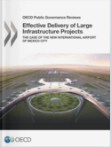
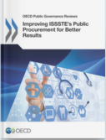



For more information on OECD work on public procurement
www.oecd.org/gov/ethics/public-procurement.htm

Slide 45
paulo.magina@oecd.org
Thank you

