Slide 1
Impact analysis of public procurement policy on MSMEs & women in the Dominican Republic
Jaime Aristy-Escuder, PhD, MSc
INTEC
November 29, 2016

Slide 2
Study Objective
To quantify the impact of public procurements made to MSMEs in the Dominican Republic.
Between March and April 2016, 408 MSMEs were surveyed, which are suppliers to the State, including 231 beneficiaries of public procurements and 177 non-beneficiaries.
In the period 2012-2015, public procurements - registered in the General Contracting Office - ranged from a maximum of 3.42% of GDP (2013) and a minimum of 1.33% of GDP (2012).
The number of suppliers increased from 25,216 (2012) to 58,970 (2015). It benefited an annual average of 7,417 companies, of which 6,284 were MSMEs.

Slide 3
MSMEs classification: Micro, less than 11 workers. SMEs between 11 and 150 workers.
MSMEs classification of beneficiaries
(Percentage)
65.8
34.2
Micro
SME
MSMEs classification of non beneficiaries
84.7
(Percentage)
15.3
Micro
SMEs
Source: Survey conducted to 408 MSMEs.

Slide 4
Gender of the owner: Sub-representation of women
Gender of the beneficiary owner
(Percentage)
59.7
21.2
19.0
Women
Men
Men’s Joint Ownership
Gender of the non-beneficiary owner
(Percentage)
52.0
38.4
9.6
Women
Men
Men’s Joint Ownership
Source: Survey conducted to 408 MSMEs.

Slide 5
Age and Education
The average owner is nearly 49 years old.
The owners of MSMEs have a median of 16 years of education.
Participation and education of owners
(Years of education)
16.0
15.6
14.3
No
Yes, but did not win
Yes and won
Source: Survey conducted to 408 MSMEs.

Slide 6
Probability of participating in the contest
The ratio of possibilities for a woman to participate in a public contest is 40% of that pertaining to a company owner if it is a man or a joint ownership.
For each year of additional education of the owner, the ratio of participating possibilities increases by 18%.
Probability of participating in contest
(Ownership of women versus men or joint)
.95
.9
.85
Probability
.8
.75
.7
8
10
12
14
16
Education
Women
Man or joint
Source: Simulation conducted by the author.

Slide 7
Probability of winning the contest
The longer you are a supplier, the more likely you are to win a contest.
If the company is owned by a man, the probability of winning the contest is 53.6% if he has been a supplier for 12 months and 61.4% for 39 months.
Probability of winning a contest
(Ownership of women versus men or joint
.7
.6
.5
Probability
.4
.3
10
20
30
40
50
60
Months as supplier
Women
Men or joint
Source: Simulation conducted by the author

Slide 8
Perception and/or experience of beneficiaries as State suppliers
58% of the survey respondents affirm that the contract is fulfilled as established.
62.3% point out that no political contact is needed to win the contest.
65.8% affirm that it is easy to participate in the contest.
72.6% indicate that anyone can be a State contractor.
55% state that no consultation is required to win.
58% declare that payments are NOT timely.
The contract is fulfilled as established
(Percentage)
Beneficiary group
58.0
40.0
Control group
38.3
28.6
21.7
13.4
Disagree
Neutral
Agree
Disagree
Neutral
Agree
Source: Survey conducted to 408 MSMEs
Political contact is needed to win
(Percentage)
62.3
Beneficiary Group
52.6
Control Group
33.1
21.6
14.3
16.0
Disagree
Neutral
Agree
Disagree
Neutral
Agree
Source: Survey conducted to 408 MSMEs

Slide 9
Impact of public procurement on the performance of the beneficiaries
Total Sales
(Percentage)
Beneficiary Group
58.9
Control Group
41.6
58.9% of the survey respondents affirm an increase in their total sales.
22.9% point out higher sales to the private sector.
37.7% declare an increase in the number of workers.
The 43.7% inform a higher investment in their equipment and machinery.
The 30.5% declare larger benefits.
71.4% affirm payment of higher taxes.
38.7
19.7
19.9
21.2
Decrease
Same
Increase
Decrease
Same
Increase
Source: Survey conducted to 408 MSMEs
Sales to the Private Sector
(Percentage)
Beneficiary Group
Control Group
47.6
57.6
29.4
22.9
27.9
14.5
Decrease
Same
Increase
Decrease
Same
Increase
Source: Survey conducted to 408 MSMEs

Slide 10
Evolution of the quality and productivity of public procurement beneficiaries
Product Quality
Percentage)
Beneficiary Group
79.7
Control Group
69.4
79.7% of the survey respondents declare that product quality has improved after public procurements.
79.2% point out that operational efficiency is greater.
70.1% indicate improvement in the organization of personnel work.
75.8% affirm better adjustment to the market.
28.9
19.9
0.4
1.7
Decrease
Same
Increase
Decrease
Same
Increase
Fuente: Encuesta realizada a 408 MIPYMEs.
Operational Efficiency
(Percentage)
Beneficiary Group
79.2
Control Group
65.3
33.5
19.5
1.3
1.2
Decrease
Same
Increase
Decrease
Same
Increase
Source: Survey conducted to 408 MSMEs.

Slide 11
Evolution of the quality and productivity of public procurement beneficiaries (Continuation)
79.2% of the survey respondents sustain that the image of the company and products has improved.
66.7% point out a higher motivation and satisfaction of the workers.
73.2% declare that the technological level of the production process is higher.
80.1% indicate professionalization improvement of those responsible of production.
81% affirm that the quality of the labor employed is greater.

Slide 12
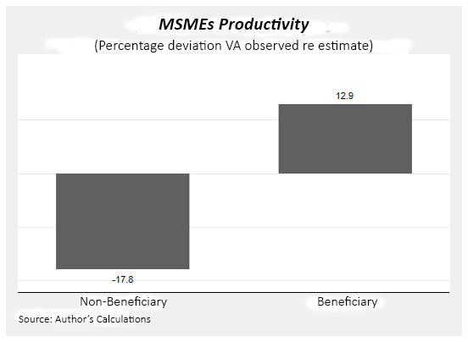
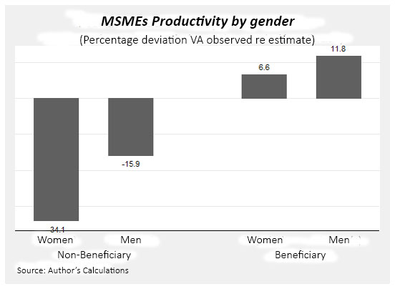
Impact of public procurement on productivity
public procurements have increased (12.9%) the efficiency and productivity of the beneficiaries. The improvement of the MSME of the beneficiary woman (6.6%) is highlighted in relation to the non-beneficiary (-34.1%).

Slide 13
The method of difference in differences
The equation to estimate the impact of public procurements is :
The interpretation of the difference in differences method is facilitated by the calculation of the fallowing expected values :

Slide 14
The method of difference in differences
The estimator of difference in differences is define as:

Slide 15
Impact on sales, salaries, profits and added value
public procurements increase by 4.1 million pesos the average annual sale of the beneficiaries in relation to the non-beneficiaries.
public procurements increase by 760 thousand pesos per year the average of the salaries paid by the beneficiaries in relation to the non-beneficiaries.
They also increase the average profits per year by 710 thousand pesos in relation to non-beneficiaries.
public procurements create added value for 1.46 million pesos per year per MSME beneficiary.

Slide 16
Macroeconomic impact of public procurement
In the year 2015, purchases were made to MSMEs in the amount of 44 thousand million pesos, equivalent to 1.43% of GDP.
The method of difference in differences, based on the statements of the companies surveyed, shows that these purchases produced a added value creation equal to 0.28% of GDP, with a minimum of 0.11% of GDP and a maximum of 0.45%.
The multiplier of public procurements to MSMEs is 0.36, similar to the capital expenditure multiplier.
The multiplier method shows that these public procurements created an aggregate value equivalent to 0.51% of GDP.
The difference between both methods suggests the existence of underreporting of the sales and profits that originated from the public procurements.

Slide 17
Women and public procurement
A major effort has been made in the period 2012-2015 to increase women's participation.
The average monthly number of contracted women owners of MSMEs increased from 287 in 2013 to 551 in 2015.
In 2013, for each woman signing a contract, 14 men signed public procurement contracts. In 2015, for each woman signing a contract, 10 men signed contracts.
In the year 2013 for each pesos awarded to a woman, a man was awarded 29 pesos per year. In 2015, for each peso that was awarded to a woman, 17 pesos were awarded to a man, which means a registered reduction of 41.3%.

Slide 18
Women and public procurement
Data from the Central Bank shows that the unemployment rate for women is 22.4%, while 8.2% belongs to men.
It should be noted that in 2015 the average monthly salary of men amounted to 16,392 pesos, while that of women was 13,433 pesos. When comparing these averages with the average monthly salary of the beneficiary companies (35,707 pesos), the income for women would result in 165.8% higher.
This reality implies that the public procurements made to businesses managed by women have a positive and significant impact on the wellbeing of that segment of the population.

Slide 19
Recommendations
It was proven that public procurements have a positive effect, both on micro and macroeconomic levels.
The main difficulty revealed by MSMEs is payment delays.
The authorities should explore the possibility of creating fiscal instruments to allow discount, at low interest rates, of receivable invoices held by MSMEs.
An invoice transferable to any taxpayer should be created.
The payment of ITBIS to the tax authorities after the supplier receives payment from the Government would also be very positive.

