Slide 1
Nuevos Desafíos de Compras Públicas Sostenibles en América Latina y el Caribe
New challenges of Sustainable Public Procurement in Latin
America and the Caribbean
November 29, 2016
Marina Ruete

Slide 2
Contenido l Content
Sustainable Public Procurement
Compras Públicas Sostenibles
Relevance of SPP in Caribbean countries
Re-thinking SPP: Product-service systems
Innovation
Sustainable Infrastructure
Relevancia de las CPS en el Caribe
Re-pensar CPS: Sistemas producto-servicio
Innovación
Infraestructura sostenible

Slide 3
Caribbean Islands l Islas caribeñas
Still shy on SPP initiatives…
Jamaica PP Policy Statement objective:
“Sustainable development through minimizing negative impact on the environment”
“Value for Money is primary, with particular attention to efficiency, effectiveness, quality and sustainable development for the long term”

Slide 4
Caribbean Islands l Islas caribeñas
Still shy on SPP initiatives
Sectors relevant to SPP that can be “greened”
Water
Solid waste
Fishing and acquaculture
Energy
Public Procurement
Environmental Impacts

Slide 5
Caribbean Islands l Islas del Caribe
Water Stress
Economies highly dependant on freshwater: tourism and agriculture
Support water conservation and efficiency:
  Buy water-efficient products
  Check the supply chain

Slide 6
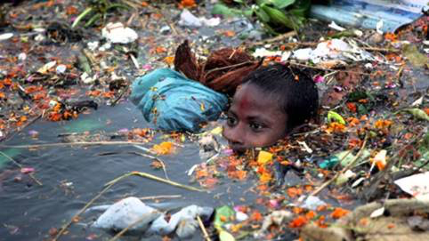
Caribbean Islands l Islas del Caribe
Solid Waste and Marine Litter
Products: Food and kitchen wastes, paper, glass, metal and plastic containers and packaging, construction wastes, clothing, and hazardous wastes
Processes: Disposal and recycling
Do a product life cycle assessment before buying
  Require environmentally preferable materials/components/chemicals
  Change plastic/disposable goods for permanent/reusable ones
  Control amount of packaging
  Require disposal or recycling service to your suppliers
  …. From waste to energy

Slide 7
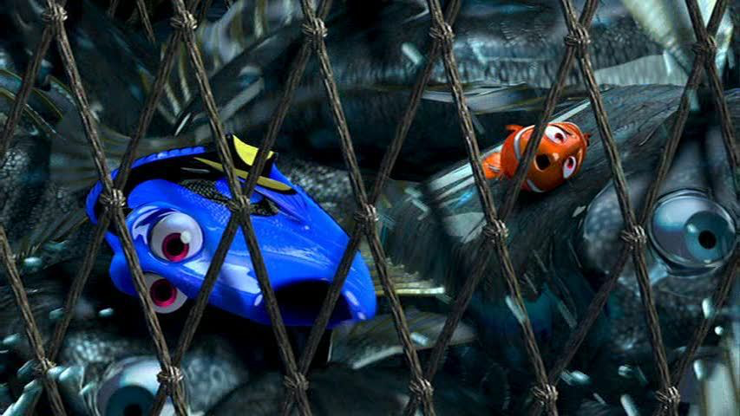
Caribbean Islands l Islas del Caribe
Un-sustainable Fishing
Overfishing, destructive fishing practices, poor fishing management
Buy sustainable seafood
From companies following your regulations
Certifications
Economic Impact Opportunity:
More than 64,000 people are directly employed in small-scale fisheries and aquaculture,
Approx. 200,000 people working indirectly in fishing related activities including: processing, retail, boat construction and net repair.
Main fish producing countries in the Caribbean: Guyana (31% of total production), Suriname (21%), the Bahamas (11%) and Trinidad and Tobago (7%)

Slide 8

Caribbean Islands l Islas del Caribe
Dependant on fossil fuels
Depend on fossil fuels to meet their energy needs
Only 3% of the energy mix in the Caribbean is renewable energy
Support renewable energies
- Transition to use of renewable energies
- Buy products that use renewable energies

Slide 9
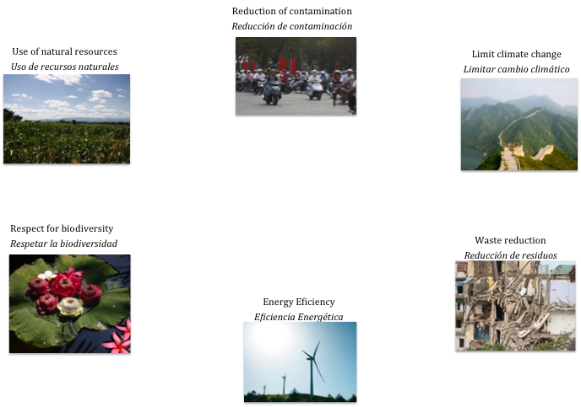




Caribbean Islands l Islas del Caribe
Consumo
Consumer
Desecho
Disposal
Recursos naturales
Natural resources
Fabricación
Manufacturing

Slide 10
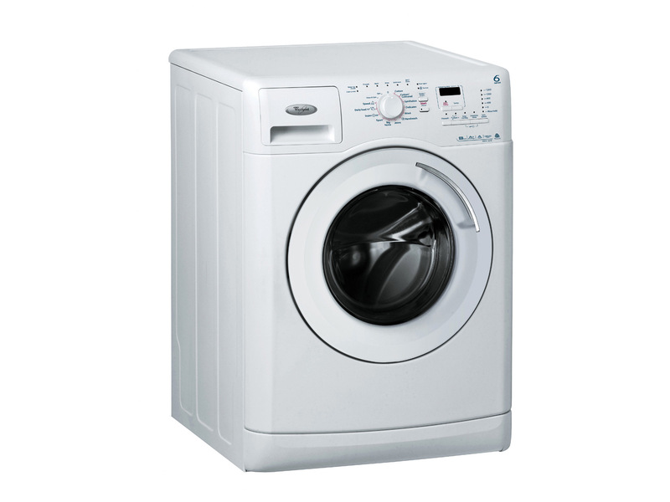

Re-thinking Public Procurement l
Re-pensar Compras Públicas
What do we demand? ¿Qué buscamos?
Product? Or Utility? ¿Producto? o ¿Resultado?
Traditional business focus: buy a physical product
New focus: mix of product and service
Enfoque tradicional de negocio: comprar un producto físico
Nuevo enfoque: mix de producto y servicio
Product-Service Systems Sistemas Producto-Servicio

Slide 11
Re-thinking Public Procurement l
Re-pensar Compras Públicas
Why do it? ¿Porqué hacerlo?
Transfer life-cycle management of assets – risk transfer
Supplier might be better equipped to do jobs not essential to government
Transferencia de la gestión del ciclo de vida del producto – transferencia de riesgo
Proveedor puede estar mejor posicionado para realizar trabajo no esenciales al gobierno

Slide 12
Re-thinking Public Procurement l
Re-pensar Compras Públicas
Link to SPP Relación con CPS
Decouples consumption from economic growth
You meet more needs with lower materials and energy use
Note: Design over the whole life-cycle
Separa el consumo del crecimiento económico
Se satisfacen más necesidades con menos materiales y uso de energía
Nota: Debe diseñarse pensando en toda la vida de un producto

Slide 13
Re-thinking Public Procurement l
Re-pensar Compras Públicas
How to do it? ¿Cómo hacerlo?
Define your need (function to fullfil) + performance indicators
Tender: duration, distribution of ownership, risk management and guarantees and minimum detail of products and ss
Duration needs to be longer
Engage with your market
Defina su necesidad (función a cumplir) + indicadores del rendimiento
Pliego: duración, distribución de la propiedad, gestión de riesgo, garantías y detalle mínimo de prod y ss
Duración debe ser más larga
Dialoga con el mercado

Slide 14
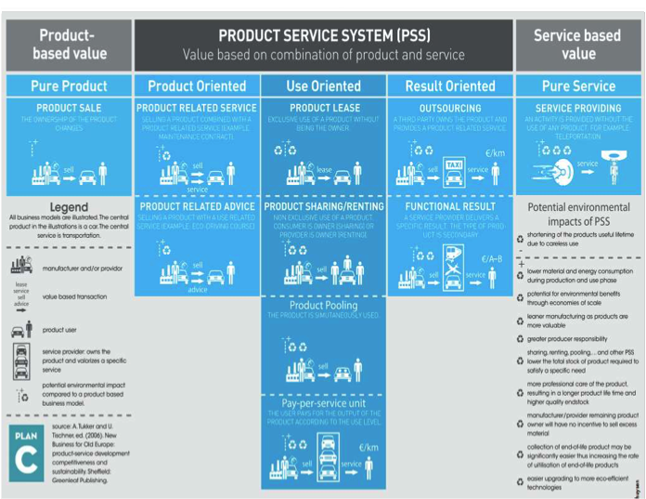
Re-thinking Public Procurement l
Re-pensar Compras Públicas

Slide 15
Innovation l Innovación
New paradigm: Public procurement: from administrative process to “smart” procurement management.
Why? Public procurement can influence the demand to boost innovation and sustainability
What it takes: Strong political commitment
  Forward thinking attitude
  Motivation
  Awareness
  Able to handle failure
Case of Paraguay
IISD + OEA + RICG + CRDI l IISD + OAS + INGP + IDRC

Slide 16
Innovation l Innovación
Challenges:
  Expertise of the unknown – Evaluation phase
  Financial resources to finance costly trials
Tools:
  Need of market and collaborative dialogue
  Functional based specifications: ensures more creativity in the offers.
Opportunities: SMEs: new ideas can be tested spontaneously without passing long procedures of permission seeking
Case of Singapore´s support to driveless cars
IISD + OEA + RICG + CRDI l IISD + OAS + INGP + IDRC

Slide 17
Interlink with “smart” urban infrastructure l Relación con infraestructura urbana “inteligente”
Caribbean infrastructure deficit requires US$ 21 billion over the next 11 years.
Just under 50% can possibly be publicly financed or funded.
    Need to increase efficiency in the delivery of public infrastructure and public services
    Infrastructure has to be sustainable: financial, environmental and socially sustainable
    Value-for-money across the asset life cycle

Slide 18
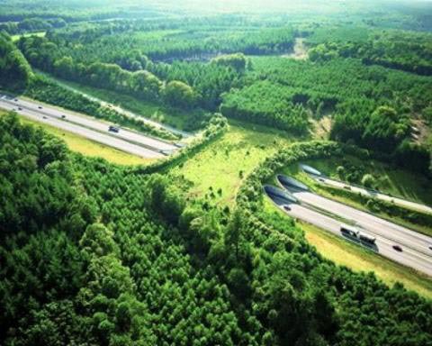
Growing expectations on Public Private Partnerships (PPP) l Crecientes expectativas en las Asociaciones Público Privadas (APP)
Financially sustainable:
  US$1.2 million Caribbean Regional PPP Support Facility
  Not all infrastructure can be deployed as PPP that bring value-for-money across the asset life cycle
Sustainability:
  Environmental and Social Impact
  Assessment
  Permits
  Contract clauses
Biggest challenge in the PPP
cycle is the procurement phase

Slide 19
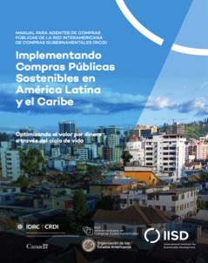


What can you do to implement SPP? l ¿Qué puedo hacer para implementar CPS?
Manual l Handbook
Curso Virtual l Online Course
Licitaciones piloto l
Pilot Tenders

Slide 20
Marina Ruete marina.ruete@iisd.org
www.iisd.org

