Slide 1
Sustainable Procurement:
Suggestions for Small Developing States
Barbara Morton
Director, Sustainable Procurement Ltd
Third Sub-Regional Caribbean Public
Procurement Conference
Bridgetown, Barbados 14 June 2016

Slide 2
Suggestions for Small Developing States
Introductions
Who?
Why?
  Sustainable Public Procurement as a ‘strategic enabler’
  Delivering sustainable outcomes through procurement
What?
  Relevant & Proportionate actions
How?
  Focus, Prioritise, Embed, Innovate

Slide 3


Who?
.
Sustainable Procurement Ltd
  London, Hampshire & Scotland
Specialists in training and consultancy
  UK and Marrakech Task Forces on SPP
Clients: over 40 countries in 10 years
  ITAIPU BINACIONAL – Brazil/Paraguay
    through Fundación Moises Bertoni
  African Development Bank
  Chile - through British Embassy in Santiago
  Swiss-Ghana Project with Ghana Public Procurement Agency
  Cleantech Innovations Geelong, Australia
  Scottish Government

Slide 4
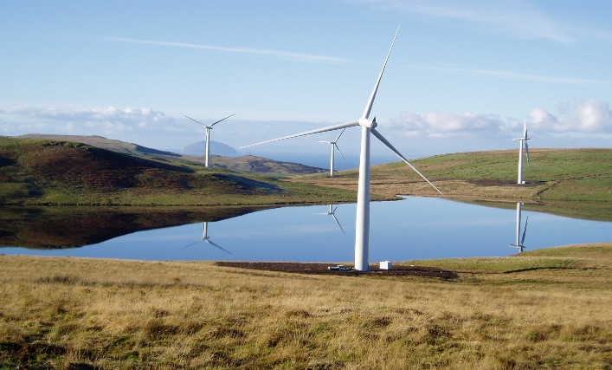


Why?
Using sustainable procurement (= good procurement) to deliver intended outcomes
What’s important to you?
Social, economic & environmental
Sustainable Procurement is a ‘strategic enabler’
Examples:
  Mauritius – quality of imported goods vs. alternatives
  Ghana – Green Building Council
  Appropriate technologies

Slide 5

Example: Scotland’s Approach
Scottish Model of Procurement
Improving supplier access to public contracts
Delivering savings and benefits
Embedding sustainability in all we do
Maximising efficiency & collaboration
Public procurement in Scotland
= £10+ billion per annum
Quality
Cost
Sustainability

Slide 6
Sustainable Procurement ‘Golden Thread’
International and national laws, policy priorities and commitments
Organisational frameworks, policy priorities, commitments and targets
Tools & techniques:
Prioritisation methodology
Procurement strategies,
action plans and
targets
Organisational Procurement Strategy
Life cycle impact mapping
Projects,
products
services
Product & supplier selection

Slide 7
Example: Mapping Policy Priorities
‘Organisational Priorities’
Policy & Strategy
Carbon Reduction
Recyclable/ Recycled Goods
Fair & Ethical Trade
Local Sourcing
Innovation
Health Improvement
Equality and Diversity
Accessibility
Waste Reduction
Community Benefits
Energy and Resource Efficiency
A Healthy and Protected Environment
Regeneration, Jobs and Skills
Construction
Cost Savings
Safer Communities
Transport
Climate Change Adaptation

Slide 8
How?
Focus on priorities – for small developing states
You can’t do everything at once!
Focus on what’s most relevant and proportionate AND what will deliver greatest benefit
Using a risk-based approach
Risk, Opportunity, Scope to Improve & Market Influence
Amount of Spend
Risk Score
Scope to do More
Influence on Suppliers

Slide 9
Risks and Opportunities
Environmental | Socio-economic
CO₂ and other Greenhouse Gases | Employment, skills and training
Materials | Health and wellbeing
Waste | Communities
Hazardous materials | Security and crime
Biodiversity | Ethical and fair trade
Heritage | Equality Fair Work
Water
i
Click for guidance
Full descriptions, guidance on who should use the tool, when and how is available within the Tool.
Notes:
Explain that these are headlines only – detail beneath.
Link to National Outcomes and Indicators.

Slide 10
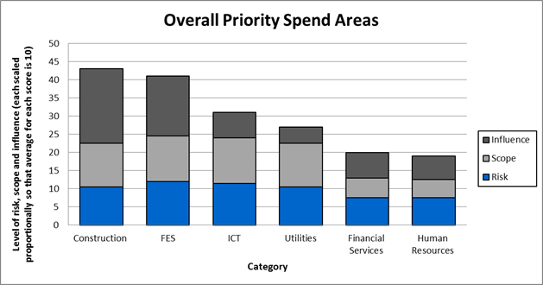
Example: Prioritising Actions

Slide 11
Market engagement strategy –
Scope and Influence
Challenge
Pioneer
Scope
Encourage
Research & Development
Influence
Notes:
Market Engagement Strategy
A score has been determined for each of the spend categories for influence. These are now mapped individually against this matrix to determine the overall priority and the approach to market engagement. Here, the matrix contrasts scope and influence to determine the focus and general priority the spend has in relation to all other expenditure areas within an organisation.
Pioneer: Drive market and suppliers to maximise sustainability opportunities.
Challenge: Challenge the supplier to embrace the opportunities present. Put sustainability on agenda with suppliers - as an issue and opportunity.
R&D: Push suppliers/ markets to undertake research to stimulate innovation.
Encourage: Work with suppliers to raise awareness of sustainability issues.

Slide 12
Sustainable Procurement Tools
Prioritisation Tool
Category /sub-category/ commodity or equivalent level
Excel based
Macros enabled
Flow process
Graphical outputs and summary of key findings for Export
  Sustainability Test
Contract level
Excel based – no macros
Flow process
Summary of relevant risks and opportunities for contract and guidance on how to apply
Policy
Prioritisation
Category strategy
Sustainability Test
Frameworks & Contracts

Slide 13
Sustainability: at the heart of all we do
The Scottish Government
Marrakech approach
700 public procurement professionals trained
Community benefits
Environmentally conscious
renewable power generation
sell green electricity back to the grid
Electricity
Commonwealth Games 2014
351 Jobs, 113 Apprentices
Glasgow Housing Association
energy efficiency measures
Socially responsible
3500 Training opportunities
Supported businesses
Public Contracts (Scotland) Regulations 2015
Procurement (Scotland) Regulations 2016
577 Apprentices, 482 Trainees

Slide 14
Procurement Reform (Scotland) Act 2014
Procurement Reform (Scotland) Act 2014
Sustainable Procurement Duty
Consider:
Improving
Economic, social, environmental, wellbeing and reducing inequality in the area.
Involving
Small and medium enterprises and 3rd sector bodies including supported businesses.
Promoting
Innovation
Notes:
A number of duties and provisions in the Act cover ‘the slice’, the sustainable procurement duty covers all public procurement and must be evidence above regulated procurement levels (£50K and £2m)
8 General duties
(2) A contracting authority must also comply with the sustainable procurement duty.
9 Sustainable procurement duty
(1) For the purposes of this Act, the sustainable procurement duty is the duty of a contracting authority
(a) before carrying out a regulated procurement, to consider how in conducting the procurement process it can
(i) improve the economic, social, and environmental wellbeing of the authority’s area,
(ii) facilitate the involvement of small and medium enterprises, third sector bodies and supported businesses in the process, and
(iii) promote innovation, and
(b) in carrying out the procurement, to act with a view to securing such improvements identified as a result of paragraph (a)(i)
(2) The contracting authority must consider under subsection (1) only matters that are relevant to what is proposed to be procured and, in doing so, consider the extent to which it is proportionate in all the circumstances to take those matters into account…
(4) In this section, references to the wellbeing of the authority’s area include, in particular, reducing inequality in the area.
The duty is topped and tailed by other parts of the Act:
Community Benefit requirements;
Climate Change provisions;
Drawing down of supported business provision; and
Public bodies must – publish a corporate procurement strategy setting out how they intend to carry out regulated procurements and review annually. Strategy must illustrate how procurement will contribute to functions and achievements of purposes; it must comply with sustainable procurement and other general duty; describe policies relating to community benefits and consulting and engaging with those affected by procurements.
Public bodies are required to report on performance against strategy annually.
Non-compliance with general duties is actionable. (Paragraph 37)

Slide 15
Identify life cycle impacts
Impacts of obtaining raw materials Sourcing overseas if demand outstrips supply – impact on carbon emissions Wood should be sourced from legal, sustainable forests/woodlands – forest management critical Potential impact on biodiversity of forests/ woodlands if focus is only on economic viability Support development of an immature supply chain through aggregated demand Opportunities for community woodland schemes to be integral to supply chain | Impacts of manufacturing & logistics Carbon emissions from transportation, particularly if local supply chains are inadequate Production of chips/pellets – is renewable energy used Sourcing overseas if demand outstrips supply – impact on carbon emissions Competition for raw materials e.g. chipboard manufacturers Waste products from pellet manufacturing process
Impacts during use of product/service Emissions particularly in ‘Air Quality Management Areas’ Shortage of qualified engineers/installers; through aggregated demand an opportunity to influence recruitment and training Disposal of waste products e.g. ash | Impacts at end-of-life / disposal Disposal of ash – use as a fertiliser Disposal of boilers
Notes:
Participants divided into groups to flipchart results of this exercise.
Use a familiar product such as a laptop for this exercise.
Focus here is on environmental, socio-economic, reputational risks at each stage.
So participants may start by identifying the raw materials used and the elements that may be impacted upon before assessing what those impacts may be - trainers should challenge them to identify as many impacts as possible – pollution, depletion of natural resources, working conditions, etc.
For feedback ask one group to present ‘Raw materials’ and ask other groups to add anything new they have then move to ‘manufacturing & logistics’ etc. make sure in discussion that delegates think how they would use this for services.
Also discuss how far back in the supply chain can we make a difference, reducing impacts.

Slide 16
Embed in Procurement Cycle
Identify need & assess risk
Specification
Supplier Selection
Evaluation and Award
Supplier Management
Contract Management
Good Procurement is Sustainable Procurement
Stakeholder
and supplier engagement
Notes:
Explain that sustainability needs to be embedded and is not a bolt-on but part of good procurement.
This slide illustrates that the course continually relates to the ‘procurement cycle’ and its key stages – BUT particularly emphasises that Stakeholder and Supplier Engagement is a major consideration at every stage of that cycle and this will be referred to throughout the course.
Stakeholder and Supplier engagement in developing SPP approach includes:
Developing approach to SPP
Why, Who, How; Risks, barriers & challenges;
Stakeholders as part of the delivery process
Innovation; leadership; consultation; identifying common priorities; shared learning;
Certification, accreditation and standards; legal considerations;
Types of engagement
Benefits of co-operating on promotion of SPP
Risks of not co-operating and working together:
Stimulating new product development
Risks, barriers and challenges; legal considerations; Pre-Procurement

Slide 17
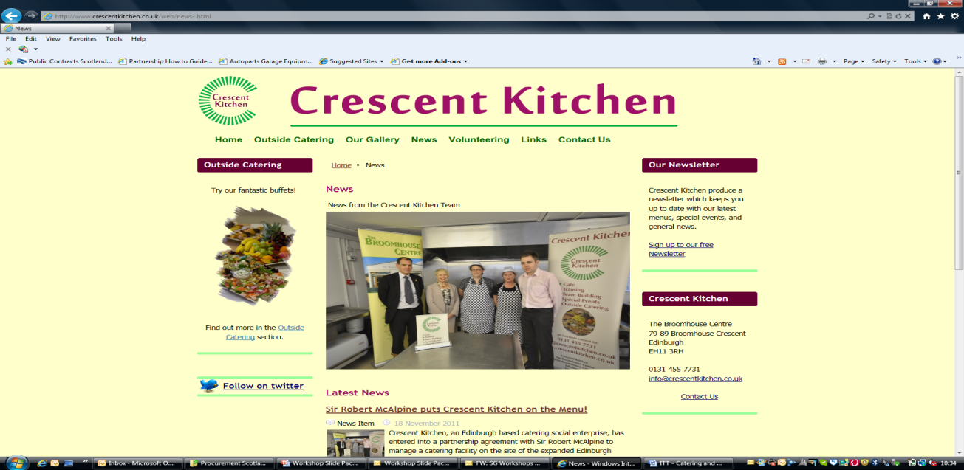

How? Engaging Suppliers
Engage early
Send a strong signal to the market
Maximise the opportunities for innovation
Encourage them to invest in Research & Development
Deliver sustainable solutions to meet your needs
Examples:
  Scotland’s ‘Developing Markets for Third Sector Providers Programme’

Slide 18
The Flexible Framework – a route map
Lead
People
Objectives, policy and communications
Procurement process
Engaging stakeholders
Monitoring and reporting
Enhance
Ambition
Practice
Embed
Foundation
Time

Slide 19
Summary
Public procurement is a ‘strategic enabler’
Focus on priorities
Apply a risk- and opportunity-based approach
Involve all relevant stakeholders early
Encourage innovative solutions, relevant to economic & social context
Monitor and track progress
Public procurement can deliver sustainable outcomes

Slide 20
Thank you for your attention
Barbara Morton
Sustainable Procurement Ltd
+44 (0)7766 023560
barbara@sustainableprocurement.eu.com
www.sustainableprocurement.eu.com
http://www.gov.scot/Topics/Government/Procurement/policy/corporate-responsibility/Sustainability/ScottishProcess/SustainableProcurementTools

