Slide 1
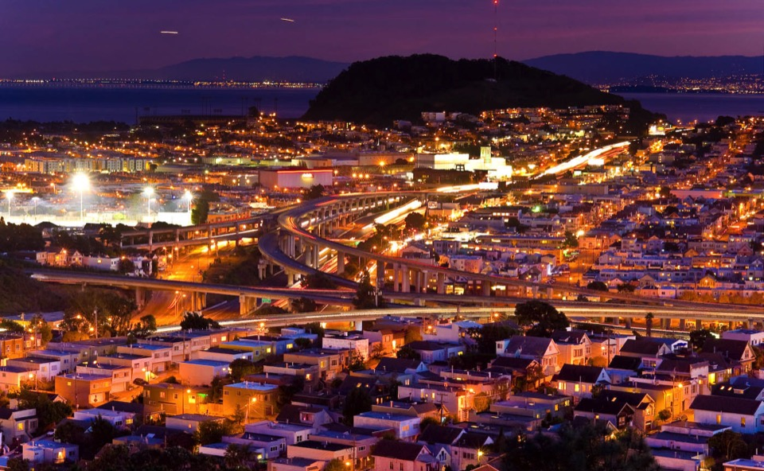
Monetizing gains from Sustainable Public Procurement
5 - 6 April 2016 INGP workshop

Slide 2
Why do we measure gains of SPP?
Achieve better value-for-money
Makes the Businessecase
for SPP
Obtain the best financial, environmental and social gains
Helps prioritizing where to start
Collect reliable data for monitoring progress
Helps monitoring and
communicating progress
Notes:
The results of the tool will demonstrate why governments will achieve better value-for-money if implementing SPP. It helps building the business case for SPP.
The tool is applied to different product categories and will therefore identify the low-hanging fruit and where best to start with SPP in order to obtain the best financial, environmental and social gains.
The tool helps providing reliable data on the economic, social and environmental gains of SPP. It, thus, helps governments monitor their progress in shifting production and consumption patterns, in line with the Sustainable Development Goals

Slide 3
What does the tool do?
3 scenarios: baseline, light green, dark green per product category
Baseline scenario: existing procurement policies and practices to assess the current impacts of public procurement
Light green scenario: increased level of ambition in SPP, but aligning with current standards
Dark green scenario: stringent standards, but for which implementation is feasible
Notes:
Baseline scenario: existing procurement policies and practices to access the current impacts of public procurement and how these impacts are expected to evolve.
Light green scenario: defines an increased level of ambition in GPP, but one that alights with current standards and for which implementation is believed to be straightforward and realistically achievable.
Dark green scenario: models more stringent procurement standards or levels of implementation than are currently practiced or planned, but for which implementation is feasible
Timehorizon: 2015 to 2030 or 2050 (depends the data)

Slide 4
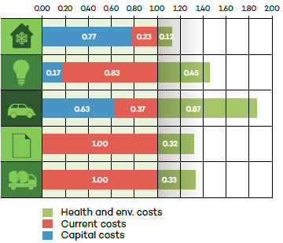
What does the tool demonstrate?
Health and environmental costs associated with CNY 1
Notes:
The figure provides a sense of the total costs of procurement in China by comparing how health and environmental costs compare to the direct fiscal costs of five products: air conditioners, lighting, cars, paper and cement. For example, CNY 1 of procurement spending on cars in China is estimated to lead to CNY 0.87 of health and environmental costs.

Slide 5
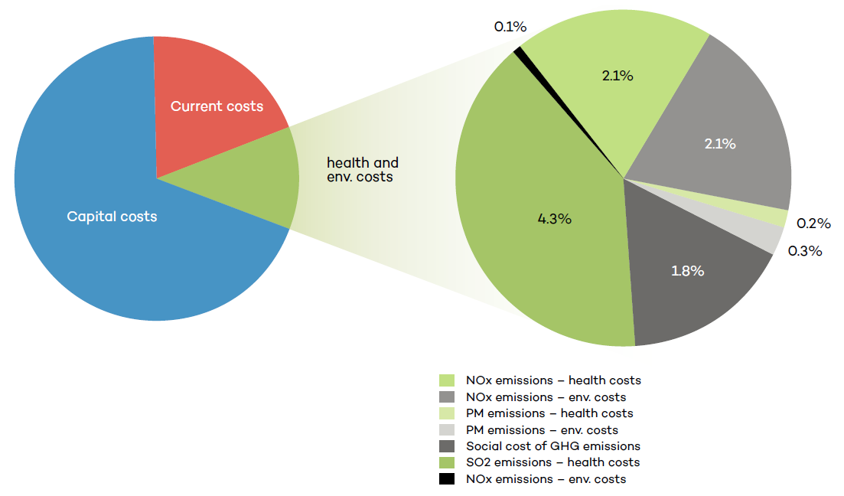
What does the tool demonstrate?
Breakdown of health and environmental costs for airconditioners
Notes:
The figure presents a breakdown of the environmental costs of air conditions purchased by public entities in China in 2015. As seen below, most of the fiscal costs stem from capital expenditure. Current costs from electricity consumption make up a relatively smaller share. A larger share of the health and environmental costs stem from the health costs of SO₂ emission associated with electricity consumption.

Slide 6
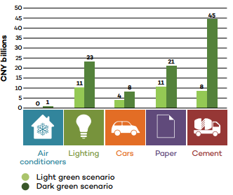
What does the tool demonstrate?
Health and environmental savings (in CNY billions)
Notes:
Figure provides an overview of the health and environmental savings (in CNY billions) under two different SPP scenarios in China. The light scenario defines an increased level of ambition in SPP but one that aligns with current standards and for which implementation is straightforward and achievable. The dark green scenario models more stringent procurement standards and levels of implementation that are currently planned but for which implementation in feasible.

Slide 7
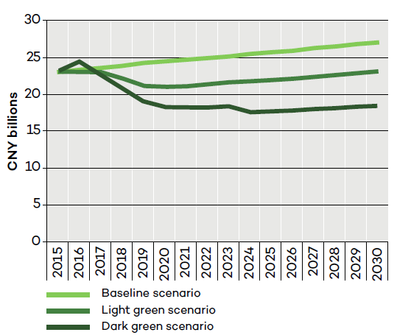
What does the tool demonstrate?
Total inclusive cost of lighting under the 3 scenarios
Notes:
The figure illustrates the total cost of lighting, including health and environmental costs under baseline, light and dark green SPP scenarios in China. It shows that it is cheaper, across the product life cycle, to buy LED lighting and smart-switch- enabled LED lighting despite higher purchase prices.

Slide 8
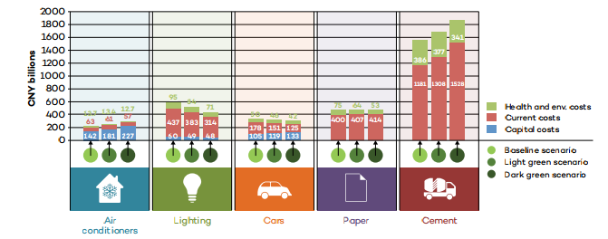
What does the tool demonstrate?
Total inclusive discounted cost of procurement under the 3 scenarios
Notes:
The figure provides a summary of the total inclusive discounted cost for 5 product categories, purchased by public entities in China, under the 3 SPP scenarios: baseline, light green and dark green. This figure shows that in the product categories of lighting, cars and paper, implementing SPP pays for its-self with over time. In other words, the higher purchasing costs are recuperated during the use of the product. For air conditioners and cement, there are increased capital and current costs associated with light and dark green scenarios. These costs will reduce in time, as markets for green air conditioners and cement develop. This is over a timeline 2015 – 2050.

Slide 9
How does the tool work?
Data collection, assumptions and modeling
Data collection
Building assumptions
Modeling
Providing recommendations and communicating the results of the model
Notes:
Data collection consists of product characteristics, procurement data current and future predictions, general data with expectations of GDP growth,
Building assumptions (IISD + government agency, based on literature reviews or primary research)
Modeling (IISD)

