Slide 1
“A New Day in Caribbean Procurement” – An Overview of the Caribbean Procurement Training and Consultancy Centre
UTech/BiPS
November 30, 2016
at the
Montego Bay Convention Centre
Jamaica

Slide 2
AIM OF PROJECT
The Caribbean Development Bank (CDB) in collaboration with the World Bank (WB) has embarked on a vision to establish the first permanent centre for procurement excellence in the Caribbean region.
The Caribbean region constitutes the scope of this project which has demonstrated cognisance of the value of professional, efficient, effective and ethical public procurement.

Slide 3
Status of Procurement in the Region
A number of the potential beneficiaries have recently or are currently implementing procurement reform programmes.
Source: From questionnaire administered to procurement officer in the BCs

Slide 4
Status of Procurement in the Region
However, in order for governments in the 21BCs to fully realise the benefits offered by public procurement, aside from legislative/regulatory and institutional reform, there is need for an increased cadre of professionally qualified and skilled procurement officers in the public service.

Slide 5
Response to Survey Questionnaire administered June – August, 2016
Majority (18) of respondents strongly agreed that there a need for appropriately trained professionals in their respective countries, the rest (7) agreed. Of the level of training required, most noted the Diploma (5) and Graduate Degree levels (7). Three respondents selected undergrad, and two (2) the certificate levels. One participant each chose a combination of Levels 2-4, and the other selected all the levels. Clearly pointing to a need for this training at the clerical to senior management levels.

Slide 6
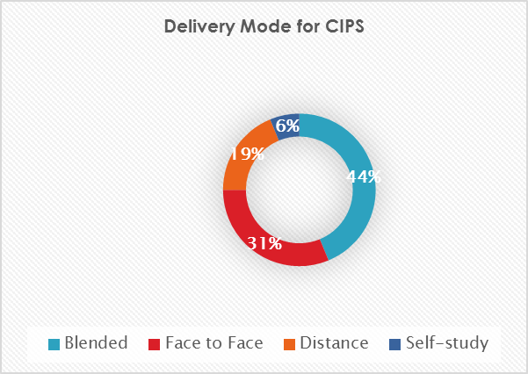
Collaboration between UTech/BiPS/CIPS
The case for internationally recognized education for procurement professionals in the modern public procurement context is strengthened by the growth of non-traditional approaches and technologies as such:

Slide 7
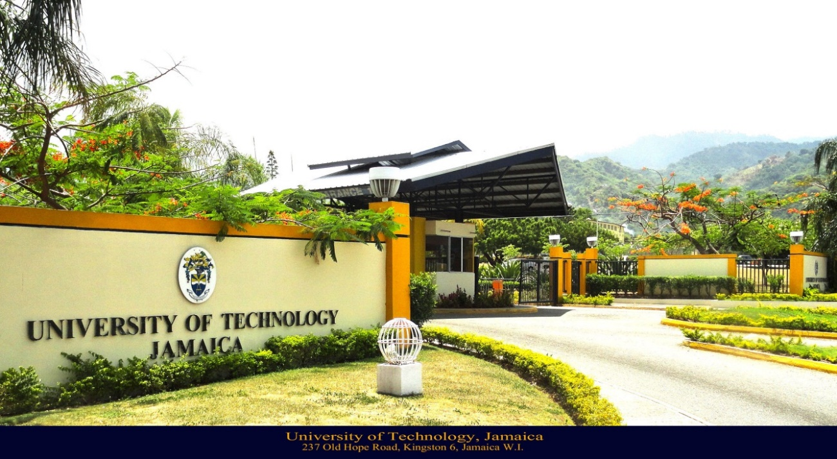
Collaboration between UTech/BiPS/CIPS
The Caribbean Procurement Training and Consultancy Centre (CPTCC), to be housed at the University of Technology, Jamaica will operate as the official Study Centre for the CIPS programme.

Slide 8
Collaboration between UTech/BiPS/CIPS
BiPS has contracted The Chartered Institute of Procurement and Supply (CIPS), a globally renowned award granting and accreditation body to provide the required qualification standards so the initial training will be accredited.

Slide 9
Collaboration between UTech/BiPS/CIPS (contd)
The CPTCC has identified an estimated pool of over 900 persons across the region trained at CIPS level 2 (certificate level) who would potentially be prime candidates for CIPS level 4 (diploma), the target of the pilot programme.
The Centre will also roll-out a Foundation Course (a 30 hour capstone course)to candidates without any formal training in Procurement practices.

Slide 10
Mission Statement for the CPTCC
To lead and support the professionalizing of procurement in the Caribbean region.
This will be achieved through the following:
education and training
promotion and contribution to international best practices
driving innovation through research,
consultancy and networking

Slide 11
Aim of the CPTCC
To bring the Caribbean together under efficient and effective procurement practices.
To increase the quality of knowledge contained within the Caribbean region, attract talent from overseas and cement the region as a guiding example of successful procurement practice.

Slide 12
ROLE OF THE CPTCC
The Centre will adopt a progressive role built upon four key service pillars namely:
Education and training (a core pillar)
Research and scholarship
Consulting Services
Information Technology (virtual and on-line delivery modes)
These pillars have been chosen for their ability to improve procurement practices within the region and generate solid growth for both the centre itself and regional procurement.

Slide 13
ROLE OF THE CPTCC
Host a number of commercial offerings in a variety of areas to support both public and private sector procurement.
Become the basis of the Centre’s operations over the first four years of existence.
Establish itself within the region as a reputable provider of procurement services.

Slide 14
Procurement market place within the Caribbean
The market for the Centre is the procurement community in public and private sectors for buyers, suppliers and other stakeholders in the Caribbean region.

Slide 15
Analysis of Potential Customers within the Caribbean Region [Market Segmentation]
Target categories of persons in the Caribbean Region who have the following characteristics:
The Marketing Plan for the CPTCC highlights the potential products and services by identified market segments with specific activities in each segment.
Category 1- Persons who are currently working in the procurement field without a degree [foundation Course (FC) and/or CIPS levels 2 to 4 and short courses]
Category 2 - Persons currently working in the procurement field with a first degree not in a procurement area [foundation Course (FC) and/or CIPS levels 2 to 4 and short courses, master’s degree]

Slide 16
Analysis of Potential Customers within the Caribbean Region [Market Segmentation]
Category 3 – Persons who have a requirement for/or interest in Continuous Professional Development (CPD) or continued education in procurement [short courses].
Category 4 – primarily high school leavers based in Jamaica who are interested in completing a four year BSc degree in Procurement, Logistics and Supply Chain Management [ foundation course and/or CIPS levels 2 to 6, undergraduate partners

Slide 17
Analysis of Potential Customers within the Caribbean Region [Market Segmentation]
Category 5 – Persons working in the procurement field who have a Graduate degree (not in procurement) and would want to pursue further training and education [CIPS levels 2 to 4 and short courses]
Category 6 – Persons working in the
procurement field who have a first degree in procurement [CIPS levels 2-6 and short courses, master’s degree]
Category 7 – persons who are not working in procurement and are interested in completing a Master’s Degree in Procurement, Logistics and Supply Chain Management [master’s degree]

Slide 18
DELIVERY MODES
Courses will be provided in several delivery methods including through a physical classroom environment, a virtual classroom environment, online e-learning and a blended approach.
We anticipate that the centre will utilise all of these methods and approaches over the medium term (four-year) plan.

Slide 19
Pathway to Training Offerings
Education & Training
Pathway | Section of Pillar | Services | Method & Approach | Target Market
 | Training
 | Professional Qualification | Foundation Course | Classroom, eLearning (Intensive) | School Leavers, Professionals requiring refresher course
 |  | CIPS Level 4 | Classroom, eLearning (Traditional) | Professionals looking for additional qualifications
 |  | MCIPS | Classroom (Traditional) | Professionals looking for postgraduate
 | Continuing Education | 5-Day Courses | Classroom, eLearning (Intensive) | Professionals looking to fill gaps in their knowledge
 |  | 1-Day Courses | Classroom, eLearning (Intensive)
 |  | Seminar | Classroom (Intensive)
 | Education
 | Degree | Undergraduate Partners | Classroom (Traditional) | Professionals looking for education in procurement theory
 |  | Master's Degree | Classroom (Traditional)

Slide 20
Types of Training and Education
This section outlines the educational offering of each of the courses offered by the Centre. These include the Foundation course, CIPS Level 4, 1-day and 5-day courses, and seminars. Overtime CIPS 2 and 3 will be added.
Foundation Course on Public Procurement
The foundation course will be a unique offering within the region, providing any individual working with or within public procurement a standardised course to quickly boost their knowledge in key areas.
It will, provide those directly or indirectly involved or interested in public procurement with a strong footing in the theory required to progress within the industry or pursue further education through CIPS or any other accrediting body.

Slide 21
Research
The CPTCC is in an ideal position within the Caribbean Region to expand its offering from educational pursuits towards original and sponsored research on a number of topics directly impacting regional public and private sector procurement.
Through this medium it will provide public and private bodies with information that can be used to overcome core industry issues.

Slide 22
Research
The Centre will focus on attracting sponsored research for organisations and businesses within the region to advance its efforts towards sustainability.

Slide 23
Consulting Services
Consulting services will be the third pillar of the commercial offering for the Centre. The services to be offered within this pillar cover various forms of consulting, including capability and capacity building, and governance and audit analysis.
Each service offered within this pillar will follow its own pathways, methods and approaches to implementation.

Slide 24
The Next Phase
Recruiting for the CIPS LEVEL 4 pilot programme which should come on stream early 2017.
Prospective candidates may apply through the - COBAM Consultancy Secretariat
University of Technology
237 Old Hope Road, Kingston 6 Jamaica
cobamconsultancy@utech.edu.jm

Slide 25
?
Questions

