Slide 1
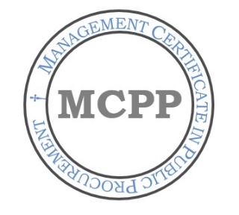
Professionalizing Public Procurement: the role of higher education Institutions Alexandru V. Roman Ph.D. Director, Research Institute for Public Management and Governance Coordinator, Management Certificate in Public Procurement Associate Professor, College of Business and Public Administration California State University, San Bernardino

Slide 2
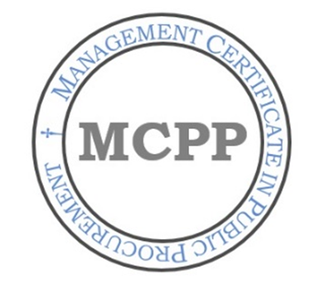
WHAT IS A PROFESSION?
Full-time occupation.
Presence and availability of training programs/schools
Establishment/presences of local and regional associations.
Establishment/presence of national/international associations.
Establishment/presence of code of ethics.
Establishment/presence of standards.
Establishment/presence of licensing.
The establishment of university programs.

Slide 3
WHAT IS A PROFESSION?
Full-time occupation.
Presence and availability of training programs/schools
Establishment/presences of local and regional associations.
Establishment/presence of national/international associations.
Establishment/presence of code of ethics.
Establishment/presence of standards.
Establishment/presence of licensing.
The establishment of university programs.

Slide 4
WHAT IS NEEDED?
Unified body of knowledge.
National and international coordination.
Higher education institutions and accreditation bodies.

Slide 5
UNIFIED BODY OF KNOWLEDGE BASE
Procurement Administration
Sourcing
Negotiation Process
Contract Administration
Supply Management
Strategic Procurement Planning

Slide 6
WHAT IS NEEDED?
Unified body of knowledge.
National and international coordination.
Higher education institutions and accreditation bodies.

Slide 7
PROFESSIONAL PROCUREMENT ORGANIZATIONS
CAPPO (California Association of Public Procurement Officers)
FAPPO (Florida Association of Public Procurement Officers)
ISM (Institute for Supply Management)
NAEP (National Association of Educational Procurement)
NASPO (National Association of State Procurement Officials)
NCMA (National Contract Management Association)
NCPPC (National Council for Public Procurement and Contracting)
NIGP (National Institute for Governmental Purchasing)
NIP (National Purchasing Institute)
UPPCC (Universal Public Purchasing Certification Council)

Slide 8
NCMA Certifications
CCCM (Certified Commercial Contracts Manager)
CFCM (Certified Federal Contracts Manager)
CPCM (Certified Professional Contracts Manager)

Slide 9
ISM Certifications
APP (Accredited Purchasing Practitioner)
CPM (Certified Purchasing Manager)
CPSM (Certified Professional in Supply Management)

Slide 10
UPPCC Certifications
CPPB (Certified Professional Public Buyer)
CPPO (Certified Public Purchasing Officer)

Slide 11
Federal Certifications
DAWIA (Defense Acquisition Workforce Improvement Act)
FAC-C (Federal Acquisition Certification in Contracting)

Slide 12
WHAT IS NEEDED?
Unified body of knowledge.
National and international coordination.
Higher education institutions and accreditation bodies.

Slide 13
WHAT IS MISSING?
HIGHER EDUCATION INSTITUTIONS AND ACCREDITATION BODIES

Slide 14
WHAT IS NEEDED?
Unified body of knowledge.
National and international coordination.
Higher education institutions and accreditation bodies.

Slide 15
CURRENT STATUS OF HIGHER EDUCATION
Only a small number of universities have public procurement programs:
California State University San Bernardino
Florida International University
Old Dominion University
No Master’s programs.
No curricula accreditation bodies.

Slide 16
CURRENT STATUS OF HIGHER EDUCATION
Only a small number of universities have public procurement programs:
California State University San Bernardino
Florida International University
Old Dominion University
NO Master’s programs.
NO curricula accreditation bodies.

Slide 17
WHY DOES IT MATTER?
Higher education is the last “step” towards full professionalization.
Critical for purposes of achieving credibility.
Developing an academia and research link.
Professional and scholarly synergies between universities, employers, government and professional organizations.

Slide 18
HOW TO ACHIEVE NECESSARY CHANGE?
Certificate programs.
Concentrations within MPA and MBA programs.
BA Degrees.
Inter-disciplinary Master’s programs.
Fully-fledged Master’s programs.

Slide 19
MCPP PROGRAM CALIFORNIA STATE UNIVERSITY
Fully online.
Five classes:
Fundamentals of Public Procurement
Project Management in Public Procurement
Public Procurement Process, Ethics and Law
Best Value Analysis and Negotiation
Contract Formulation and Administration
“Feeder” into the MPA program.
Possibility of developing into full-fledged Master’s program.

Slide 20
THANK YOU !

