Slide 1
Preventing Corruption in Procurement: A Call for Collective Action
Dr. Nikos Passas
Distinguished Inaugural Professor
Head of Collective Action and Compliance Dept.
International Anti-Corruption Academy, Vienna

Slide 2
Corruption risks
Diverts funds away from social needs,
Engenders bad decisions,
Undermines health, safety, security environment, trust in government
Distorts markets and competition,
Raises prices and costs,
Lowers quality of services and goods
Wastes resources
Kills sustainability

Slide 3
Anti-corruption
2011 Arab
Convention
2003 UNCAC
2000 UNTOC
2003 AU
Convention
1997 EU
Convention
1999 CoE
Conventions
1996 OAS
Convention
1997 OECD
Convention
Notes:
Uncac negotiated from Jan 2002 to Oct. 2003

Slide 4
National standards with Int’l application:
FCPA (1977)
Sentencing Guidelines (1991, amended in 2004)
UK Bribery Act (2010)
OECD Good Practice Guidance on Internal Controls, Ethics, & Compliance (2010)
ICC, WEF, UN Global Compact, NGO initiatives:
lots of law, principles, guidance, documents
Yet, compliance, practice and ethical norms not easily aligned

Slide 5
Signs of failure
One-sided application – v. political opponents
Impunity of high officials and companies - focus on minor offenses and low-level civil servants
Corruption estimates disappointing
Bureaucracy
Legal and regulatory complexity
Formalism
Notes:
Persson

Slide 6
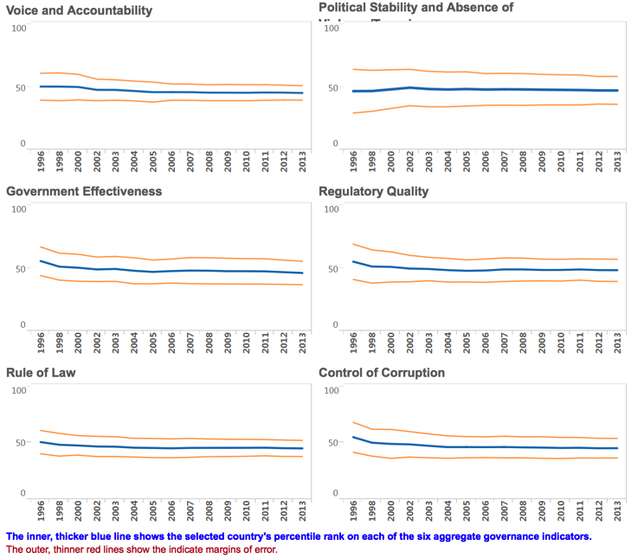

Slide 7
Challenges
Political will varies considerably among countries
Inadequate funding and support
Under-appreciation of role of monitoring/checks against illicit flows and AML
Normative unclarity, complexity and institutional malfunctions
Educational sector does not do enough towards a culture of integrity, better policies, capacity building
Fragmentation of anti-corruption work – often intentional
Notes:
Use of ACA as political tool – after opposition or to stir up feeling before lections only to abandon after them
Indonesia interference; Liberian refusal to grant prosecution power despite inaction from current authority
Under-appreciation of AML

Slide 8
Ideally
Complementary agendas and objectives
Good governance
Higher competition
Better quality of services/goods
Transparency
Value for money
Budgetary savings
Efficiency and effectiveness
Not working in practice

Slide 9
Claro/Passas findings
Over-regulation and bureaucratization risks
AC, regulatory, economic, governance failure

Slide 10
Legal Framework Issues
Proliferation of laws, rules and regulations
Frequent amendments and changes
Older/obsolete laws left in the books
Unnecessary requirements
Unnecessary complexity
Documentation is often excessive and costly. Paperless processes not always available or implemented
Normative conflicts
Inconsistent application of rules
Rigidity
Legal uncertainty
Notes:
C: Existen otras leyes o decretos que están vigentes pero son obsoletas como el decreto de austeridad en el gasto (1737/98) que restringe la compra hasta de teléfonos celulares - Sin embargo, el conflicto de interés no está reglamentado
Demasiados requisitos encarecen proceso. Por ejemplo por qué pedir fianza de cumplimiento si gobierno no hace adelantes?
Full-time staff
Repeat of paperwork every once in a while, even for each bid
C: Si bien existe una ley para evitar el uso excesivo de papel en la burocracia, la ley de compras exige que las entidades deben tener un expediente completo, con originales firmados, de todo proceso de compra o contratación, lo que hace imposible cumplir con el requisito de No papel
Lo mismo ocurre con la ley de Mipymes que es muy difícil cumplir por la excesiva tramitología que hace muy difícil que la Mipymes pueda participar en los procesos de compras pues es muy caro y engorroso hacerlo

Slide 11
Institutional Issues
Multiple agencies involved
Overlapping mandates and powers
Insufficient coordination among them
Occasional antagonism, institutional and personal tensions among agencies reach at times open animosity and mutual criticism
Lack of well organized system and uncontroversial process for the registration of providers
Notes:
C: Efecto paralizante del control desmedido y sin control ya que entidades sujetas a control en forma paralela, desmedida y sin coordinación por:
Control interno
Control de Gestión de Calidad
Contraloría
Procuraduría
Veeduría ciudadana

Slide 12
Enforcement
Formalism and legalism – obsession with process rather than substance
Nid picking for minor process violations
Fed by underlying and widespread assumption of controllers that “they are all corrupt”, need to be checked constantly and to have their discretion limited as much as possible
easy way for controllers to show they are doing something, while undermining procurement process and adding to corruption incentives
They miss the point and spirit of the laws – the objectives of good governance and anti-corruption are not promoted this way
A great deal of energy and effort go to mid- and low-level officials, rather than bigger cases of corruption, producing a demoralizing effect and lower credibility of state institutions

Slide 13
Effects on Procurement
Longer and inefficient process, sometimes leading to non-execution or no contract for missing deadlines
Higher cost
Disadvantages for SMEs and local companies
Perverse incentives: Paralyzing effect on civil servants who avoid decisions and initiatives, thus prolonging the process even further
Less initiative – reluctance to take decisions for fear of personal sanctions and public shaming
Over-emphasis on cost and numbers, under-emphasis or total neglect of quality and value for money
Notes:
C: Explican que en el 2010 habían 10 proyectos que no se implementaron por burocracia, en el 2011 fueron once proyecto que no se implementaron. Total parálisis del estado, entidades no encuentran como contratar
Costos mas altos - C: el costo de administración y del control puede en algunas ocasiones y sobre todo para compra menores ser igual o superior al costo de lo que se quiere comprar
C: En la realidad no hay incentivos al ahorro ya que el presupuesto debe ser ejecutado dentro del año o se reduce el siguiente año

Slide 14
Corruption Reduced?
Corruption is not effectively tackled via the bureaucratization and legalization of the procurement process
Circumvention through ‘directed technical specifications’
Abuse of emergency provisions
Lawful but awful: “structuring of contracts and granting to the ‘usual suspects’ – the law allows structuring, so it is legal”
Perceptions of corruption do not improve either
Honest officials freeze of fear, while corruption goes on or laws go unenforced (C) + serious rule of law challenges
Notes:
Los corruptos siguen siendo mas corruptos y quienes trabajamos de acuerdo a la normatividad solo nos han cargado mas trabajo y mas papeleo, demasiada burocracia

Slide 15
In the end, same result
Diverts funds away from social needs,
Engenders bad decisions,
Undermines health, safety, security environment, trust in government
Distorts markets and competition,
Raises prices and costs,
Lowers quality of services and goods
Wastes resources
Kills sustainability

Slide 16
Corruption v. bad governance
Can’t fight one problem by creating another with similar/same effects
Benefits of more and stricter controls ought not to be taken for granted
Normative unclarity, complexity and institutional malfunctions undermine P and AC objectives as well as overall governance, rule of law and legitimacy
Must transcend formalism and unnecessary complexity

Slide 17
Suggestions
Use what you have and do no harm
Strategy, broader context and policy rethinking
Participatory budgeting easier in smaller countries – turn challenge into opportunity
Open government
E-procurement
PPP and Collective actions
Connect anti-corruption with performance management
Performance indicators and benchmarks
Lose-lose can be turned into win-win situation

Slide 18
Suggestions
Consensus building with broad participation in brainstorming sessions on cases/scenarios/issues
Values-, results- and risk-based approaches
“Monitor with a heart”
Professionalization: continuous, inter-disciplinary (accounting, audit, legal, procurement) and hands-on training on both procurement and broader issues – integrity and accountability
Notes:
– ideas about these spring from the SME study conducted in Jamaica

Slide 19
IACA Procurement Anti-Corruption Training
https://www.iaca.int/opentrainings/procurement_training.html
The Procurement Anti-Corruption Training is a one-month programme that combines one week of on-site training at IACA with distance learning in participants’ home countries for the remaining period.
The training aims to reduce corruption in public procurement by training professionals from around the world in sound anti-corruption strategies. It is taught by Professor Christopher Yukins (George Washington University Law Schoo)l and Max Kaiser Aranda (Mexican Institute for Competitiveness-IMCO), and enriched by interviews with distinguished guest lecturers.
Participants who successfully complete the programme will receive 6 ECTS credits under the European Credit Transfer and Accumulation System
22 August - 16 September 2016, consisting of:
a pre-training phase (22 August - 4 September)
on-site training at IACA (5 - 9 September)
a follow-up phase (10 - 16 September)
DEADLINE July 15, 2016

Slide 20
Caribbean Issues
Resources
Small societies – same groups, networks, friends: conflicts
Regulatory tsunami
Pooling of sovereignty and resources? Multi-jurisdictional solution – special committee or entity with seconded officials

Slide 21
PPP risks
In countries with high levels of corruption
Corruption could be transferred from the public to the private sector
The costs of corruption could be transferred to users
Social and political costs

Slide 22
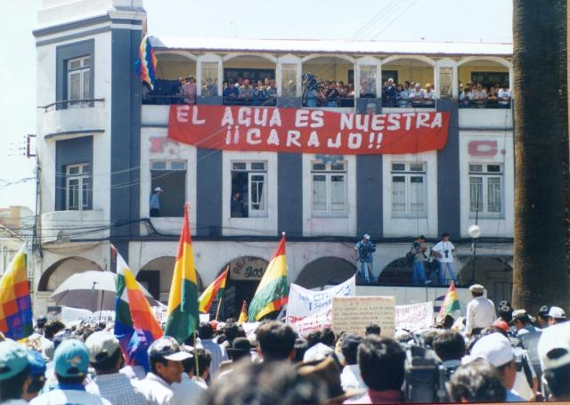
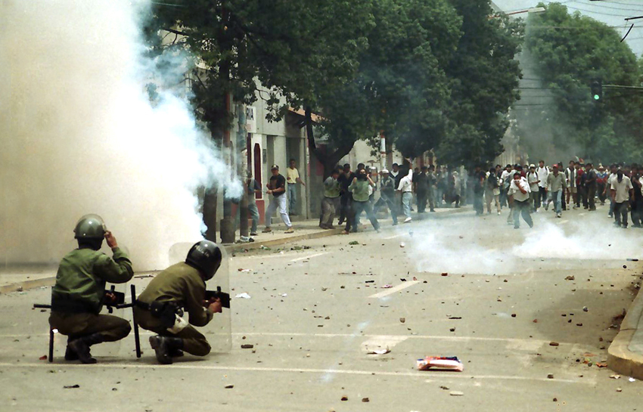
When a PPP Fails
There are numerous cases where partnering with the private sector resulted in disaster
A good example is Bolivia where a contract for the provision of water lead to the Water War
Source: https://laserna.wordpress.com/2010/10/08/la-guerra-del-agua%E2%80%A6-a-10-anos/
Source: http://www.aguariosypueblos.org/la-lucha-contra-la-privatizacion-en-cochabamba-%E2%80%93-bolivia/20_-guerra_agua/
Notes:
In 1999 in the city of Cochabamba, the water company was handed out in concession to a private consortium called Aguas del Tunari composed by international companies including the giant American Bechtel. Broad rights were granted to the consortium by law. These included the prohibition for citizens of alternative systems of irrigation; banning traditional mechanisms of water distribution (used in rural areas), furthermore, the bills skyrocketed (more than 300%) and people were charged even from the rain they could collect. The immediate consequence was a massive social discontent, people went to the streets and the mobilization ended in the water war of 2000. Under the leadership of the Coordinadora del agua y de la vida, several social groups protested for days. After violent clashes and the dead of a young protester, the government withdrawal the agreement and the consortium was expelled.

Slide 23
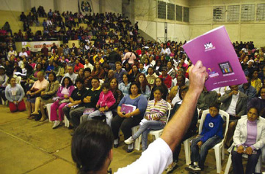
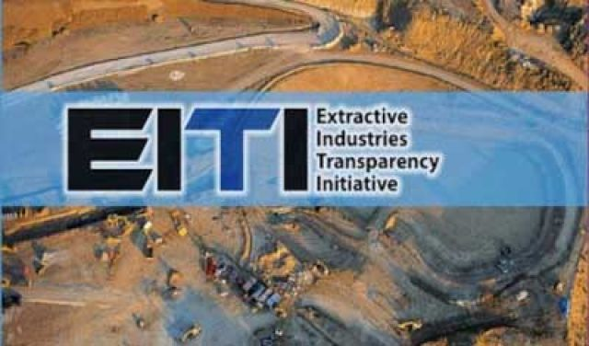
Ways to prevent corruption in PPPs
Participation of stakeholders
(Participatory Budgeting Brazil)
Mechanisms of transparency and open government
Source: http://www.pro-pag.org/what-is-participatory-budgeting.html
Source:http://firstpeoples.org/wp/the-extractive-industries-transparency-initiative-an-opportunity-for-indigenous-resource-rights/

Slide 24
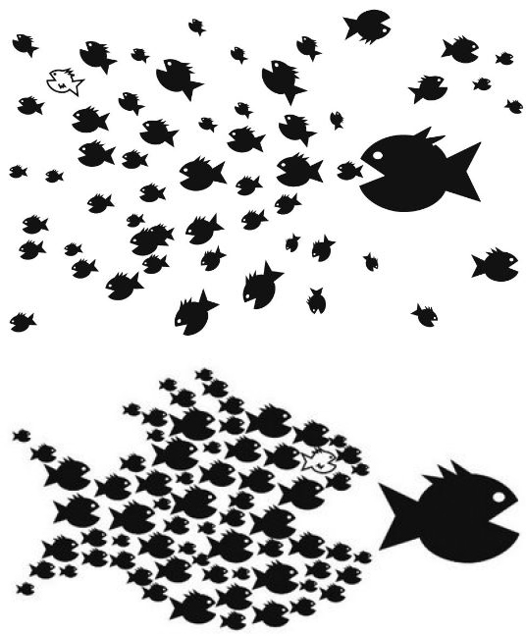
Collective action and IACA new department
The role of collective action:
Supplements legal regulation;
Sets anti - corruption standards;
Collaboration between private sector and government;
Support of participants in cases of bribe extortion;
Training
Sustainability and growth
Source:https://nznoblog.org.nz/2014/03/06/safe-staffing-at-dunedin-hospital/

Slide 25
Collective action
Types of collective action:
Anti-corruption declaration
Standard setting or principles based initiative, which can also include a certification model to monitor and audit adherence to an agreement not to bribe
Integrity Pact – usually, project based

Slide 26
Recommended Approach – many success examples
Diagnostic
Implementation
Monitor and update
Consensus
Strategy
-Institutional framework
-Legal framework
-Stakeholders
-Current practices
stakeholders, problems, sources, prioritization and exploration of solutions; steps to be taken through inclusive and participatory approaches
- Collective action
-prioritization and sequencing
-rationalization, simplification
-AC compliance incl. due diligence
- Corporate governance
-linkage of projects
-participatory budgeting
- Building trust
Specific actions:
- Start with easier targets
-PPP
-System of trade transparency and control
- tailor made systems of transparency and control
- Tailor made trainings
-Technical cooperation
Continuous assessment and feedback
Development of:
- Monitoring standards
-Performance indicators
- Baseline evaluation
- Auditing
- Peer review
- Civil society participation
-credibility, momentum
Continuous improvement
Notes:
These are the steps to follow once they accept the proposal and it also includes the detailed activities in which IACA can collaborate

Slide 27
nikos.passas@iaca.int

