Slide 1
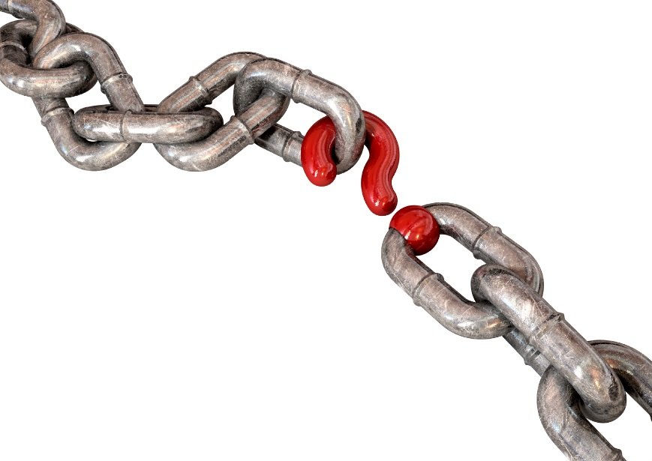
Change Management the missing link in electronic procurement implementations
Government Procurement in the Americas Conference
October 28-29, 2015

Slide 2
What is the main reason financial/procurement system implementations fail?
Project team not skilled
Lack of leadership commitment
Weak program planning
Institutional Resistance
Inappropriate technology
Inadequate Capacity to Sustain

Slide 3
What is the main reason financial/procurement system implementations fail?
Inadequate Capacity to Sustain - 30 projects
Institutional Resistance – 23 projects
Weak program planning – 22 projects
Lack of leadership commitment – 17 projects
Project team not skilled – 17 projects
Inappropriate technology – 13 projects
* Financial Management Information Systems, 25 Years Experience on what Works and What Doesn’t. Cem Dener, Joanna Watkins, William Dorotinsky. 2011.

Slide 4
What is change management?
“The process of helping people understand the need for change and motivating them to take actions which result in sustained changes in behavior”.
Organizational Change Management is NOT
Training on software
An IT service management discipline
Periodic communication on status of implementation
Taking the Sponsor to dinner
“Soft” or “Easy”
Successful change management helps organizations
and their people perform better

Slide 5
Why is change management important?

Slide 6
The reality of change - Performance
With Change
Management
CHANGE INTRODUCED
EXPECTED
CHANGE INTRODUCED
P E R F O R M A N C E
REALIZED
Optimize results
REALISTIC
ACTUAL
ACTUAL
No Change
Management
Faster change adoption
T I M E
Less disruption

Slide 7
The reality of change - People
Commitment
Denial
Preparation
Acceptance
Exploration
Resistance

Slide 8
Change interventions
Successful change requires:
Change Readiness
Leadership Commitment
Stakeholder Management
Effective Communication
Monitoring Impacts
Portfolio Management
Supporting Forces
External Demand
Fiscal Crises
Change Champions
Cross Departmental Communication
Internal Efficiency Demands
Technology Redundancy
Clear Vision
Opposing Forces
Loss of Control
Vested Interest
Weak Integration
Fear of Job Loss
Limited Awareness
Non Aligned Cultures
Time allows us to introduce only three of these

Slide 9
Leadership Commitment
Requirements for Successful Change
Change Readiness
Leadership Commitment
Stakeholder Management
Effective Communication
Monitoring Impacts
Portfolio Management
What leadership support exists?
Is it at the right level?
How are you building on it?

Slide 10
The top five mistakes top-level sponsors make during a major change
Failed to remain visible and actively demonstrate support
Failed to communicate messages about the need for the change
Failed to build a coalition of support
Assumed all employees were on-board regarding the change
Delegated or abdicated the sponsorship role
Source: Best Practices in Change Management – 2012 Edition. Prosci, Inc. 2012

Slide 11
Stakeholder Management - Addressing resistance
Requirements for Successful Change
Change Readiness
Leadership Commitment
Stakeholder Management
Effective Communication
Monitoring Impacts
Portfolio Management
Resistance to change is to be expected
Resistance must be channeled constructively and addressed directly – it cannot be ignored!

Slide 12
Meet the Stake Holders

Slide 13
Resistance - Starts with the individual
Think
Awareness of
need for change
Feel
Understand and
commit to change
Do
Translate thoughts and feelings into actions
People don’t resist change, they resist being changed

Slide 14
Which Group is the Most Resistant to Change?
Executives / Ministerial Levels
Senior-level Officials
Middle-level Managers
Front-line supervisors
Front-line employees
Other

Slide 15
Which Group is the Most Resistant to Change?
Executives / Ministerial Levels ……. 5%
Senior-level Officials ……..………... 12%
Middle-level Managers …..……….…. 37%
Front-line supervisors ………………... 16%
Front-line employees ……….……….. 24%
Other ……………………………………..…... 6%
Source: A global survey of private and public sector from Best Practices in Change Management – 2012 Edition. Prosci, Inc. 2012.

Slide 16
Addressing resistance
Leaders
POLITICAL APPOINTEES
Civil Service Executives
Middle Management must become agents for change
Middle Management
Managerial
Managerial
Supervisory
Supervisory
Front-Line Staff
Technical
Administrative
Change must be led and managed by staff within the impacted organizations
Slide 16 of 15

Slide 17
Communications
Requirements for Successful Change
Change Readiness
Leadership Commitment
Stakeholder Management
Effective Communication
Monitoring Impacts
Portfolio Management
Sources of Poor Communications:
Inconsistent messages
Not addressing why
Difficulty engaging with everyone
Long gaps between communications
Poor timeliness with regards to what is actually happening

Slide 18
Change Communications – Checking in or out?
VI. Institutionalize
Commitment
V. Adopt
IV. Install
Change Abandoned
Acceptance
Lack of
Support
Degree of Support
for the change
III. Understand
Negative Perception
II. Awareness
Preparation
Confusion
I. Contact
Unaware
Time

Slide 19
From whom do employees prefer to hear communications about the organizational need for change ?
CEO/Minister
Executive/ Senior Official
Department Head
The Employee’s Supervisor
Human Resources Representative
Project Team Lead
Change Management Team

Slide 20
From whom do employees prefer to hear communications about the organizational need for change ?
CEO/Minister …..……………………………. 47%
Executive/ Senior Official ……………. 31%
Department Head ….……………………….. 7%
The Employee’s Supervisor ……………… 4%
Human Resources Representative …… 3%
Project Team Lead ……………….………… 2%
Change Management Team …….……… 0%
Source: Best Practices in Change Management 2012 Edition. Prosci, Inc. 2012.
Slide 20 of 15

Slide 21
From whom do employees prefer to hear communications about how a change affects them personally?
CEO/Minister
Executive/ Senior Official
Department Head
The Employee’s Supervisor
Human Resources Representative
Project Team Lead
Change Management Team

Slide 22
From whom do employees prefer to hear communications about how a change affects them personally?
CEO/Minister …….……………………………. 4%
Executive/ Senior Official ..……………. 6%
Department Head ………………..………... 10%
The Employee’s Supervisor ……………… 69%
Human Resources Representative ….. 3%
Project Team Lead ……………..………….. 2%
Change Management Team ……………... 3%
Source: Best Practices in Change Management 2012 Edition. Prosci, Inc. 2012.

Slide 23
Impact of development approach on change management
Custom
More Familiar (if automate current)
Easier to Sustain
COTS
Proven Solutions
User Groups
But the lines between Custom & COTS are blurring……
Major Critical Success Factors are:
- Leadership commitment
- Engaged stakeholders
- Effective communications
- Readiness for change

Slide 24
Change Management - Common Pitfalls
Planning | Execution
Start late | Only focus on the rational
Program design fails to include change | Not dealing proactively with resistance
Create too much fanfare | Fail to understand information network
No sense of urgency | Over rely on structure and systems to change behavior
Not involving all stakeholders | Fail to target communications and provide feedback mechanisms
Not creating a coalition of leaders | Over rely on consultants
Ignoring culture | Fail to consider organizational capacity
Forcing through too much change | Declare victory too soon

Slide 25
Thank You !!
3110 Fairview Park Drive
Suite 1100
Falls Church, VA 22042
T: 703.663.2480
F: 703.852.7333
www.evansincorporated.com
Richard Hudson
Director
T: 202.330.3832
F: 703.852.7333
rhudson@evansincorporated.com

