Slide 1
Transparency and Integrity in Public Procurement June 2, 2022

Slide 2
Hello!
I am Andrei Bennett
I am here because I love to give presentations on public procurement
You can find me at:
opppcustomercare@mof.gov.jm

Slide 3
ROADMAP
Define integrity
Jamaica’s Practice
1
3
2
Observations about transparency

Slide 4
1.
Integrity defined

Slide 5
Integrity in public procurement
Refers to the idea that procurement should be carried out without any influence of corruption.
Arrowsmith S. et aux “Public Procurement Regulation- an introduction” P 8
Notes:
Corruption can cover various types of practice and may involve various forms of collusion between government and bidders, notably:
Awarding contracts on the basis of bribes,
Awarding contracts to firms in which one has a personal interest;
Awarding contracts to firms in which one’s friends, family or business acquaintances have an interest;
Awarding contracts to political supporters (e g. to firms who have provided financial support; or to regions which have voted for a particular political party, and
Avoiding corruption and conflicts of interest.

Slide 6
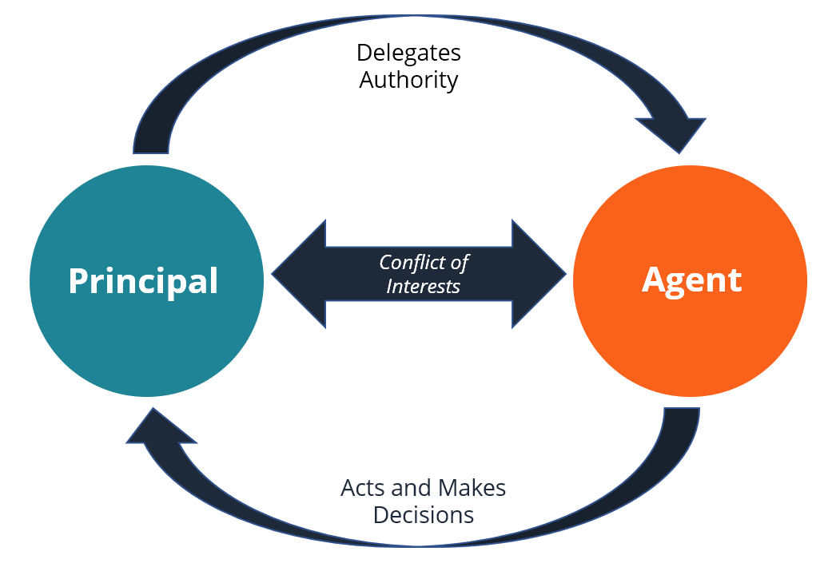
Principal Agent
Notes:
Corruption can cover various types of practice and may involve various forms of collusion between government and bidders, notably:
Awarding contracts on the basis of bribes,
Awarding contracts to firms in which one has a personal interest;
Awarding contracts to firms in which one’s friends, family or business acquaintances have an interest;
Awarding contracts to political supporters (e g. to firms who have provided financial support; or to regions which have voted for a particular political party, and
Avoiding corruption and conflicts of interest.

Slide 7
The definitional debate
In a majority of cases such corruption ordinarily refers to the use of public office for private gains, where an official (the agent) entrusted with carrying out a task by the public (the principal) engages in some sort of malfeasance for private enrichment which is difficult to monitor for the principal.”
P. Bardhan, “Corruption and Development: A Review of Issues”, (1997) Journal of Economic Literature, pp. 1320–1346
Notes:
In common usage the word “corruption” is used to mean different things in different contexts. Even if we choose to confine ourselves only to the economic context, staying away, for example, from related issues of political corruption (i.e., where the ill-gotten gains are primarily in terms of political power), there are alternative denotations of economic corruption.
“…the definitions of corruption matter greatly, and for two main reasons: first, they determine what we are trying to capture when we measure corruption; second, they condition the manner in which we understand the nature of the problem and, as a result, how we develop strategies to combat corruption” S. Andersson and P. Heywood, ‘The Politics of Perception: Use and Abuse of Transparency International’s Approach to Measuring Corruption’ (2009) 57 Political Studies, 746–767 @ 750

Slide 8
Integrity in public procurement
State stability and security
Value loss in contract implementation
International embarrassment
Notes:
Most people judge the integrity of the state by reference to the procurement system!
Value can be lost due to the substitution of substandard materials
Loss of state aid

Slide 9
Limitations of procurement regulation
Procurement regulation can only limit or remove the opportunity for corrupt practices which arise as a result of the procurement function. Seeking to go beyond this by over-regulating merely imposes obstacles to efficiency and professionalism in procurement.
P. Trepte, Transparency and Accountability as Tools for Promoting Integrity and Preventing Corruption in Public Procurement (2005) (paper to OECD Expert Group meeting on Integrity in Public Procurement).

Slide 10
2.
And what exactly is transparency?

Slide 11
Origins trans- “across, beyond, through” parere- “come into sight, appear, submit, obey”

Slide 12
Transparency
Something on the other side comes entirely into sight

Slide 13
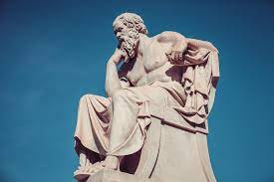
Philosophical Considerations
Intrinsic value
Valuable for its own sake
Instrumental Value
Valuable to achieve some other objective

Slide 14
Transparency is directional
Transparency upwards
Transparency downwards
Transparency outwards
Transparency inwards

Slide 15
3.
Transparency in GOJ procurement

Slide 16
GOJ Procurement Transparency
Largely instrumental

Slide 17
Institutional Aspects
Integrity Commission
Power to investigate the award of government contracts to ensure that such contracts are awarded on merit
Further powers to deliver requisitions to public officers and all public officers earning above threshold submit annual report!

Slide 18
Institutional Aspects
Office of the Auditor General
Power to investigate the award of government contracts to ensure that such contracts are awarded on merit
Lays report in Parliament on findings of breaches of rules and regulations governing public procurement

Slide 19
Regulatory Aspects
Section 5 of The Public Procurement Act 2015 (“the Act”)
Integrity as an objective
Section 30 or Section 34(3)(f) of The Act
Publication of rules governing each competition
Section 41 of The Act
Publication of notice of cancellation

Slide 20
Regulatory Aspects
Section 39 of The Act
Requirement to keep records
Section 43 of The Act
Oversight of process decisions
Section 45 of The Act
Notice of contract award

Slide 21
Allied Tools
Electronic Procurement!
Audit trail
Preserved historical records
Efficient publication

Slide 22
Thanks!
.

