Slide 1
Green Public Procurement and new law regarding GPP and Circular Procurement
Raquel Carvalho – rmcarvalho@ucp.pt

Slide 2
Green Public Procurement
Green Public Procurement and UN SDG

Slide 3
Green Public Procurement
Green Public Procurement in Portugal:
Public Contracts Code (revised in 2021): Tender specifications may include environmental aspects (art. 42); these aspects may be included in the evaluation of bids (art. 75); Costs shall be seen from a life-cycle cost perspective (art. 75);
Other relevant Portuguese hard law:
Waste Management regime (Decree-Law no. 102-D/2020 of 10th December): public procurement as a tool to promote a better waste management and the use of recycled products and materials (art. 7); mandatory green requirements – at least 10% of materials used in the construction or maintenance of infrastructures must be recycled (art. 28)
Climate Framework Law (Law no. 98/2021 of 31st December): Public procurement as one of the ways for public administrative bodies to pursue climate goals; technical specifications and/or factors in award criteria related to energy consumption in the phases of production and use; assessment of the energy spent in the supply chain; use of LCC and circular factors
Regulations:
National Strategy regarding the transition from linear to circular economy – PP as a tool;
National Green Public Procurement Strategy – 12 Guidebooks.

Slide 4
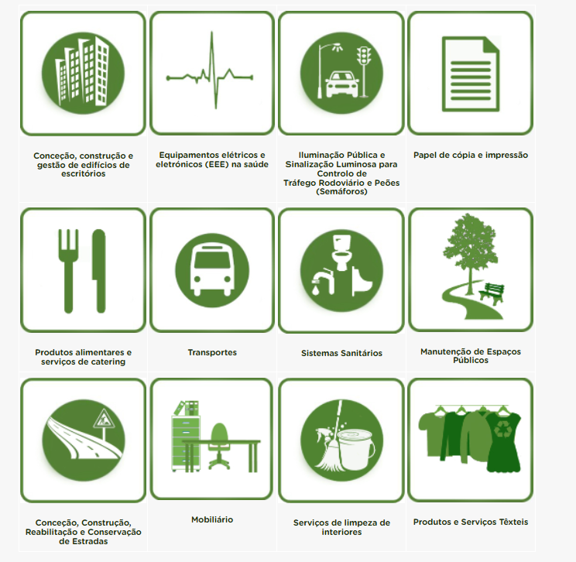
Green Public Procurement
Presently – 12 Guidebooks
By May 13th, there were three more Guidebooks under public consultation:
Space Heaters and Hot Water Preparation Heaters;
Graphic Representation Equipment, Consumables and Printing Services;
Data Centres, Server Rooms and Cloud Services.

Slide 5
Green Public Procurement
The draft legislation: Law of Circular and Green Public Procurement (Project Law no. 41/XV/1.ª - https://www.parlamento.pt/ActividadeParlamentar/Paginas/DetalheIniciativa.aspx?BID=121391), which establishes:
criteria and deadlines for the implementation of Circular and Green Public Procurement;
the role of public and administrative bodies in raising the awareness of the market, economic operators and consumers towards environmental concerns and sustainability;
a set of concepts: “Circular and Green Public Procurement”; “Life Cycle Costing”; “Circularity”

Slide 6
Green Public Procurement
Circularity: “procurement based on the principles of reduction, reuse, recovery and recycling of materials and energy, according to which the value of products and materials is produced, composed and maintained for as long as possible, waste production and the use of resources is reduced to a minimum, and when products reach the end of their useful life, their resources remain in the economy to be re-used and re-used and re-generated value”
Circular green procurement: “the acquisition of a set of goods or services set of goods or services considered as priorities, integrating environmental technical specifications and requirements in the pre-contractual stages, with effects for the subsequent phase of contractual execution”;
LCC: “calculation technique that allows estimating the total cost associated with the useful life of the product, work or service, as well as the environmental externalities, in the long term, and includes the extraction and refining of raw materials, manufacturing and other phases of production, the use and maintenance phases, until disposal”.

Slide 7
Green Public Procurement
Circularity: “as a «product-as-a-service» or other models, where producers retain ownership of the product or responsibility for its performance throughout its life cycle, the digitization of product information, including solutions such as digital passports, tagging and watermarking, and by encouraging the use of rewarding products based on different sustainability performance, including by linking high levels of performance to incentives”.
LCC calculation: reference to art. 75, no. 7 PPC, but adds some other costs (?): “a) The cost of acquisition and all costs directly or indirectly associated; b) Operating costs, including energy consumption; c) End-of-life costs, such as decommissioning or disposal costs; (d) the cost of externalities, such as the cost of emissions of greenhouse gases and other greenhouse gases with a detrimental effect on the climate and the environment”.

Slide 8
Green Public Procurement
Let’s compare…
Art. 75, no. 7 PCC | Art. 2, no. 4 draft
(a) Costs related to procurement itself; (b) User costs, such as energy consumption, consumption of consumables and other resources; (c) Maintenance and technical assistance costs; d) End-of-life costs, such as collection and recycling costs; e) Costs imputed to environmental externalities linked to the good, service or work during its life cycle, as long as its monetary value can be determined and confirmed, which may include the costs of emissions of greenhouse gases and other pollutants, as well as those for mitigating climate change. | a) The costs of acquisition and all costs directly or indirectly associated therewith; b) Operating costs, including energy consumption; c) End-of-life costs, such as decommissioning or disposal costs; d) The costs of externalities, such as the emissions of greenhouse gases and other pollutants with a detrimental effect on the climate and the environment.

Slide 9
Green Public Procurement
Objetive scope: public contracts of the Public Contract Code;
Subjective scope: only contracting authorities of the Public Contracts Directive (not entities operating in the water, energy, transport and postal services sectors)
Tools: factors in the award criteria or tecnhical specifications or both;

Slide 10
Green Public Procurement
Mandatory percentages of green factors within public procedures and framework agreements:
“Contracting entities that are part of the direct or indirect administration of the State, corresponding minimum to 60%”;
“The State business sector, corresponding to minimum 40%”;
“The local authorities and the entities they integrate, the corresponding 40%”;
“The concessionaires of public services, according to the notion defined in no. 2 of article 407 of the Public Contracts Code, the corresponding to 60%”.
Notes:
Regarding local government, there is a transitional measure: a five-year period of adpatation;
Regarding concessions, the rule applies only to those which begin after the enter into force of the law;
Th epercentages depende upon the existence of Manuals

Slide 11
Green Public Procurement
There are a set of factors: environmental and social sustainability; energy-effciency; local or regional products; circularity; LCC; management and operational eficiency;
The risk of abandoned procedures and the importance of pre-planning:
The role of preliminary market consultation – to obtain information from the market;
The possibility of “bids integrating environmental solutions and criteria other than those stipulated in the procedure, provided that they also meet the environmental objectives and requirements sought by the contracting authority”.

Slide 12
Green Public Procurement
Shall the preliminary market consultation be reviewed?
Considering the imperative assessment model, is it viable to admit the possibility of criteria other than the requested in the procedure documents? If so, what measures should be taken?

Slide 13
Green Public Procurement
Preliminary market consultation and innovation: should innovation be seaked through planning?
Should PP be a driver to market change or are economic operators’ business models already fit to answer with innovative and circular proposals?
Notes:
Contracting autorities: the case of Porto municipality that has joined the Solar Project of 2034 - having recently been included by the European Commission in the group of 100 European cities that will lead carbon neutrality on the Continent by 2030.

Slide 14
Green Public Procurement
The importance of monitorization of green contracts and public sharing of results by public administrative bodies (art. 6);
The importance of contracting authorities reporting the fulfilment of mandatory requirements in public contract procedures;
The Court of Auditors is responsible for imposing sanctions for non-compliance

Slide 15
Green Public Procurement
The Final Monitoring Report of 2020 ENCPE – (https://encpe.apambiente.pt/content/relat%C3%B3rio-final-de-monitoriza%C3%A7%C3%A3o?language=pt-pt):
SWOT analysis and main vulnerabilities:
Insufficient availability of human and material resources of the entities that constitute the MAG to perform the tasks associated with the implementation of the ENCPE 2020.
Delay in the preparation of tools to support the implementation of the strategy (e.g. preparation of guidebooks) and the necessary awareness-raising actions and training of public administration entities.
The voluntary nature of the instrument conditions the adhesion of the entities and consequently its effectiveness.

Slide 16
Green Public Procurement
Need for further improvements in the operationalization and use of the Base Portal regarding the monitoring of the use of environmental criteria in public procurement.
Difficulty in involving the State’s business sector and Local Administration.
High diversity of agents that intervene in general government procurement processes, with very diverse degrees of knowledge and perceptions of GPP.
Absence of monitoring and dissemination of results during the implementation of the strategy, as well as of a feedback mechanism to monitor the use of the guidebooks and the results obtained.
The limited perception of the results in terms of environmental performance of organizations as a result of green procurement does not promote adherence.
Insufficient awareness of a large part of economic operators regarding environmental issues/circular economy, which hinders and restricts competition when environmental criteria are included in pre-contractual procedures.

Slide 17
Green Public Procurement
Some thoughts…
Circularity and the absence of all of circular concepts;
How to conciliate the local/regional preference (in the draft law and PCC – art.42, no. 6 e) – “enhancement of the local and regional economy”; art. 75, no. 2 d) – “use of products of local or regional origin”) and competition?
Are mandatory green factors the best solution (France has chosen this tool: art. 2152-7: at least one factor in the award criteria must be environmental)? Or is a sectorial approach more adequate? Why?
Notes:
“1. Public procurement has the potential to aid climate change objectives through trendsetting behaviour, but more data/research is required to further foster this development; 2. The current legislative landscape is geared towards legal possibilities to procurement sustainable outcomes instead of mandating it, mostly due to the 2014 reform of the Public Procurement Directives; 3. I argue that article 11 TFEU or 18(2), even in combination with the CJEU's Tim case and 69(3) Directive 2014/24/EU, are either not obligatory for contracting authorities, and even if they are obligatory, they are ineffective for a number of reasons (onus of proof, legal uncertainty etc); 4. Under the influence of the EU Green Deal, we are currently on the brink of a paradigm change, meaning that we will see more obligations popping up in the future (like the Clean Vehicles Directive, which was the long time standing exemption). Construction, food, energy etc.; 5. The recent Commission proposals of amongst others Batteries, Ecodesign and Sustainable Construction Materials include articles on Green Public Procurement in which different legislative approaches are taken to mandate green procurement. 6. Three approaches are visible: 1. mandatory requirements in the Directive/Regulation, 2. mandatory requirements in the Directive/Regulation icm with a delegated compentence for the Commission with some guidance criteria or 3. only a delegated competence for the Commission. 7. Finally, the question arises who should set the sustainability levels in Europe and through what legislative procedure. I question the approach to leave it up to the Commission to do this.”

Slide 18
THANK YOU!
rmcarvalho@ucp.pt

