Slide 1
Shaping The Future Through Sustainable Public Procurement: Special and Differential Treatment Jamaica

Slide 2
Objectives
This presentation will:
Briefly describe the Government of Jamaica’s pathway to the inclusion of SPP in the domestic legislation
Outline particular legal and procedural rules related to the Special and Differential Treatment regime
Share experiences/results

Slide 3
A brief timeline
2008- Ministry of Finance together with Ministry with responsibility for industry agreed on the need for greater inclusion of MSMEs in government procurement
2010- Ministry of Finance through INGP and IDB obtained funding to commission study of factors affecting MSME participation in government procurement
2010- Stakeholder workshop involving MSME groups, manufacturers and chambers of commerce
2015- Passage of The Public Procurement Act 2015 to include relevant supporting objectives
2017- Approval of “Offsets Public Procurement Policy Framework”
i. To serve as a sustainable form of social safety for marginalized and disadvantaged groups who cannot produce to compete with large local and global efficient producers;
ii. To create local employment to counter the challenge of jobless growth and growth without equity

Slide 4
A brief timeline
2018- Promulgation of The Public Procurement Regulations to include “Special and Differential Treatment Measures”
2019- Preparation of draft policy to support operationalization and passage of Special and Differential Treatment Orders
2020- Commencement of pilot

Slide 5
The legislation
S(5) The Public Procurement Act 2015 (as amended)
The objects of this Act are to-
(i) encourage participation in public procurement
(ii) encourage growth by enabling the participation of small, micro and medium sized enterprises in public procurement

Slide 6
The legislation
Two orders pursuant to Regulation 44 and Regulation 46
The Public Procurement (Domestic Margin of Preference) Order 2019
The Public Procurement (Set Asides) Order 2019

Slide 7
The legislation
Regulation 41 of The Public Procurement Regulations 2018
With the purpose of improving the distribution of wealth and income within Jamaica, and to reduce costs of public prcoruement, including the national developmental costs, special and differential treatment measures may be applied to a procurement proceeding to-
Encourage the participation of Jamaican suppliers in public procurement opportunities;
Increase the cpaacity of Jamaican suppliers to compete for procurement contracts; and
Develop Jamaican industries

Slide 8
Regulation 43- Domestic Margin of Preference
Applicable in International Competitive Bidding
Allows 20 per cent margin on bid price of international bidder for the purpose of comparison
If Jamaican bidder’s price falls within the 20 per cent margin, then contract is awarded to Jamaican bidder PROVIDED THAT
Jamaican bidder includes at least thirty-five (35) per cent domestic content

Slide 9
Regulation 46- Set Asides
MSME Set Asides
20 per cent of total government budget is set aside for MSMEs as defined
MSME only competitions using “rule of two”
Contract awards according to normal procurement methods
Industry Set Asides
100 per cent of government budget for spend in certain industries is set aside for Jamaican suppliers
Jamaican only competitions
Contract awards according to normal procurement methods

Slide 10
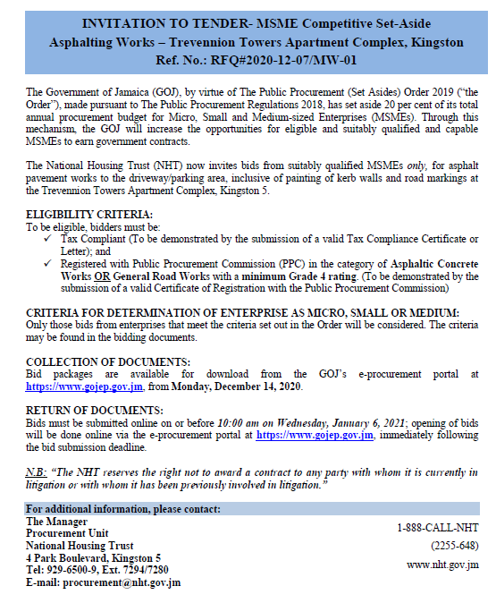

Slide 11
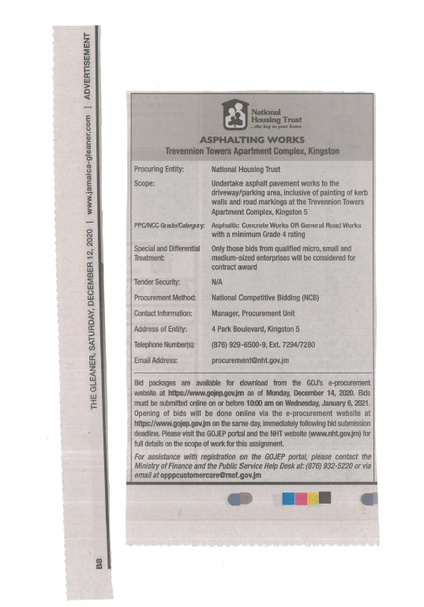

Slide 12
Experiences and results?

Slide 13
Thanks!
Any questions?
You can find me at:
andrei.bennett@mof.gov.jm

