Slide 1
Shaping the Future through Sustainable Public Procurement – Green Buildings
ECS INGP UNEP CDB OAS
Webinar 16th April 2021
Professor Anthony Clayton, CD

Slide 2
By 2050
9-10 billion population, about one-third more than today.
About 75% population urban, up from 55% today.
Means building 3-4 new cities/year for the next 30 years, each of them size of Mexico City (population >21m).
We will consume 30% more water, 50% more energy, 70% more food, 100% more materials (from 80Gt to 160Gt); half will be sand, cement and gravel for construction.
But can we survive the transition to this future?
Is the material demand sustainable?
Climate change: on track for 3.2°C warmer by end century. Parts of planet’s surface could become uninhabitable, as 1/3rd of Antarctic ice sheets could collapse, Middle East/Gulf region too hot/arid, much of Bangladesh underwater, coastal cities flooded.
Notes:
https://edition.cnn.com/2021/04/08/world/ice-melt-antarctic-intl-scli-scn-climate/index.html

Slide 3
Why buildings?
Building construction and use responsible for over 1/3rd global final energy consumption, nearly 40% of total CO2 emissions.
Making buildings more efficient can solve climate change, plus cheaper to operate, which gives increased disposable income, growth in other sectors of the economy.

Slide 4
Finding solutions
Greatest need for more efficient buildings in tropical/sub-tropical regions, where new cities will be.
Harder to keep interior cool, dry in hot, humid climate than keep it warm in a cold climate.
To solve problem, we built an NZEB - first in Jamaica & Caribbean, one of first in tropics.
NZEB generates the power it consumes. E+ produce more, sell to others.
If all buildings NZEB, can close many power stations.

Slide 5
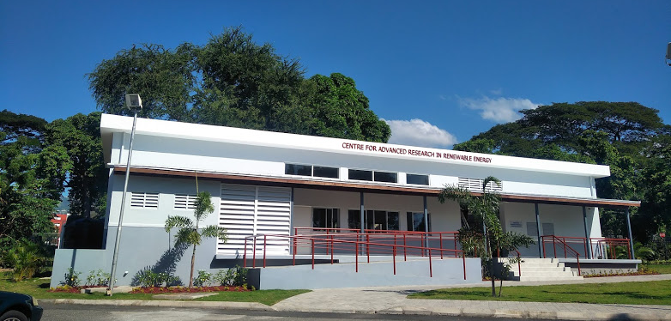
First NZEB in the Caribbean

Slide 6
Key findings
Some effective ways to make a building energy efficient cost little/nothing.
Orient building to sun, not parallel to road. Reduces unwanted heat gain, improves efficiency of solar panels.
Put living spaces in interior, service areas on outside walls. Keeps living spaces cooler.
Maximize natural light for illumination, use natural ventilation.
Simple changes in layout and design reduce waste of energy.

Slide 7
Need to solve more than one problem
Not just an engineering problem.
Building regulations specify minimum standards, and few government regulations aimed at net zero.
Education. Architects/contractors have to know how to design/build NZEB.
Demand. People must know they have buildings that cost nothing to operate.
Fiscal system. Taxes on imports of key technologies makes them less attractive.
Low purchase price from utility makes selling less viable.

Slide 8
But….
Most construction in Caribbean based on cement and steel.
Each of these industries contributes about 8% of world carbon emissions. Second only to the fossil fuel industry as the world’s largest source of carbon emissions.
Prevalent building type has high embodied energy/carbon cost.
Also has high thermal mass, not designed to minimize unwanted heat gain or utilize passive cooling solutions.
This means that they require constant cooling in order to remain at a tolerable internal temperature.

Slide 9
Thank you !

