Slide 1
Multi-Sectoral Coordination – COVID-19

Slide 2
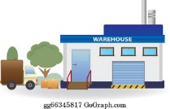
Integrated Regional Logistics Mechanism (IRLM) – COVID-19
❶
❷
❸
❹
❺
Approved
Needs Lists from Member States
Procurement
Integrated Regional Logistics Hub
BARBADOS
Delivery to Member State
Last Mile Distribution
Collate
Movement
Air/Sea Bridge
Actions by Member States
Regional Logistics and Procurement Actions
Combined actions -national, regional, other

