Slide 1
COVID Supply Chain
COVID Supply Chain
June 3, 2020

Slide 2
Multi Pronged Approach
Procurement Actions
National/Regional/Local
Centralized Management
State/Regional/National
Adjudication of Requests
Prioritization of immediate need
Short and long term strategy

Slide 3
Supply Chain Expansion Line of Effort
Responded to state requests for more personal protective equipment by contracting and with three textile manufacturers to produce a total of 88.6 million reusable level-1 isolation gowns.
Connected a U.S. manufacturer with trade associations to partner and expand hand sanitizer production capacity.
Facilitated a joint initiative between a U.S. medical manufacturer and a retailer to provide 8.4 million isolation gowns to the private market within three months.
Provided assistance to multiple non-medical manufacturers which allowed them to retool existing facilities to create millions of masks.

Slide 4
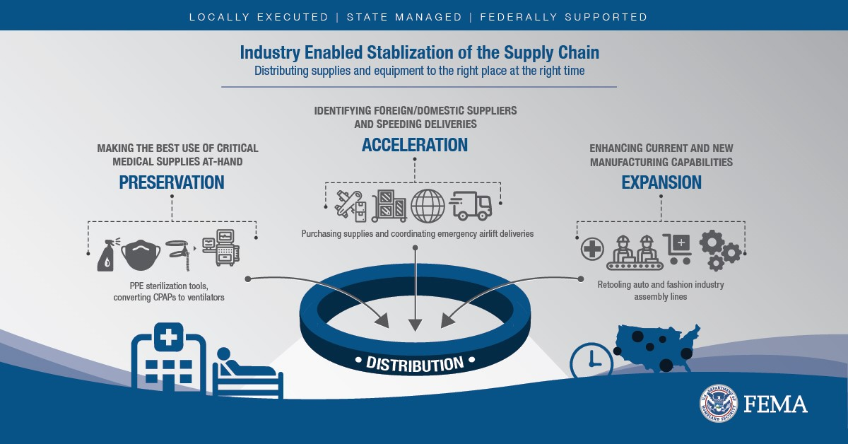
Supply Chain Stabilization

Slide 5
Supply Chain Stabilization
The preservation line of effort focuses on providing federal guidance to responders and the non-medical sector, such as public service (police, fire, EMT), energy distribution and the food industry on how to preserve supplies when possible, to reduce impact on the medical supply chain.
The acceleration line of effort provides direct results to help meet the demand for personal protective equipment PPE through the industry to allow responders to get supplies they need as fast as possible

Slide 6
Project Air Bridge

Slide 7
Air Bridge
Overseas flights arrive at operational hub airports for distribution to hotspots and nationwide locations through regular supply chains. Flight arrivals do not mean supplies will be distributed in the operational hub locations.
Per agreements with distributors, 50 percent of supplies on each plane are for customers within the hotspot areas with most critical needs. The remaining 50 percent is fed into distributors’ normal supply chain to their customers in other areas nationwide. HHS and FEMA determine hotspot areas based on CDC data.

